Slide 1
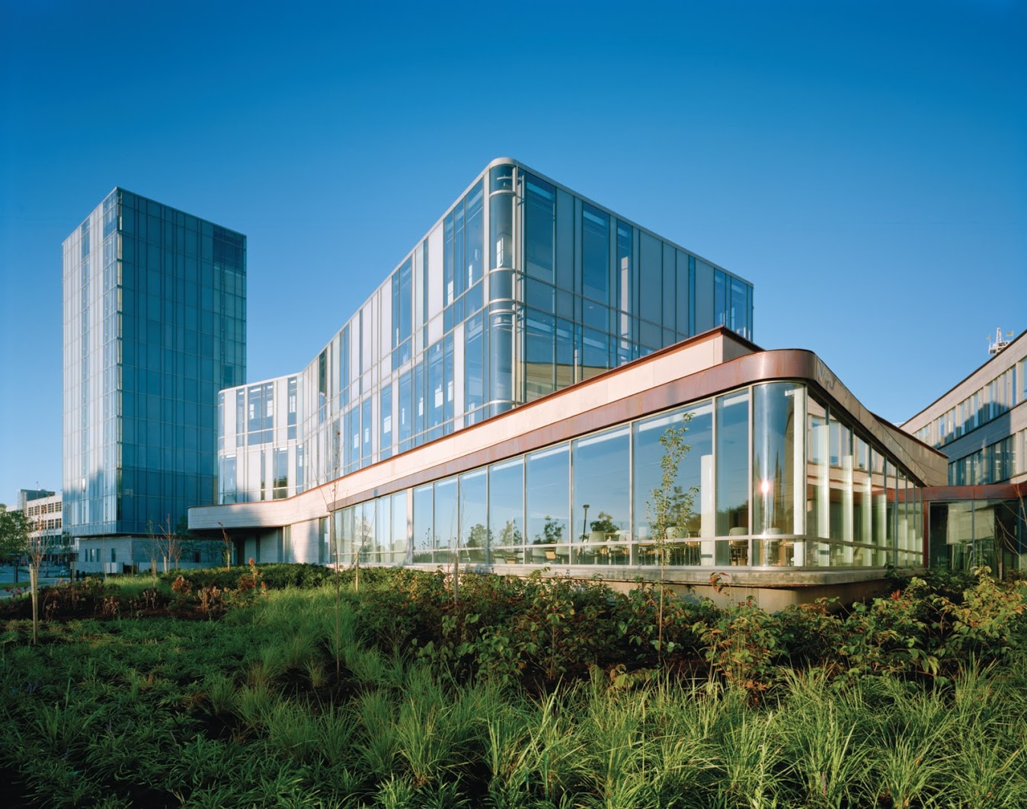
`
Schulich School of Business MBAN 6120
MODULE 9, 10 : PACF and forecasting
Data Science II
Instructor: Boris Garbuzov
MBAN 6120
Fall 2020
SCHULICH SCHOOL OF BUSINESS | MBAN 6120
MODULE 1
Data Science II
2020

Slide 2
Chapter 3 ARIMA Models
3.3 Autocorrelation and Partial Autocorrelation

Slide 3
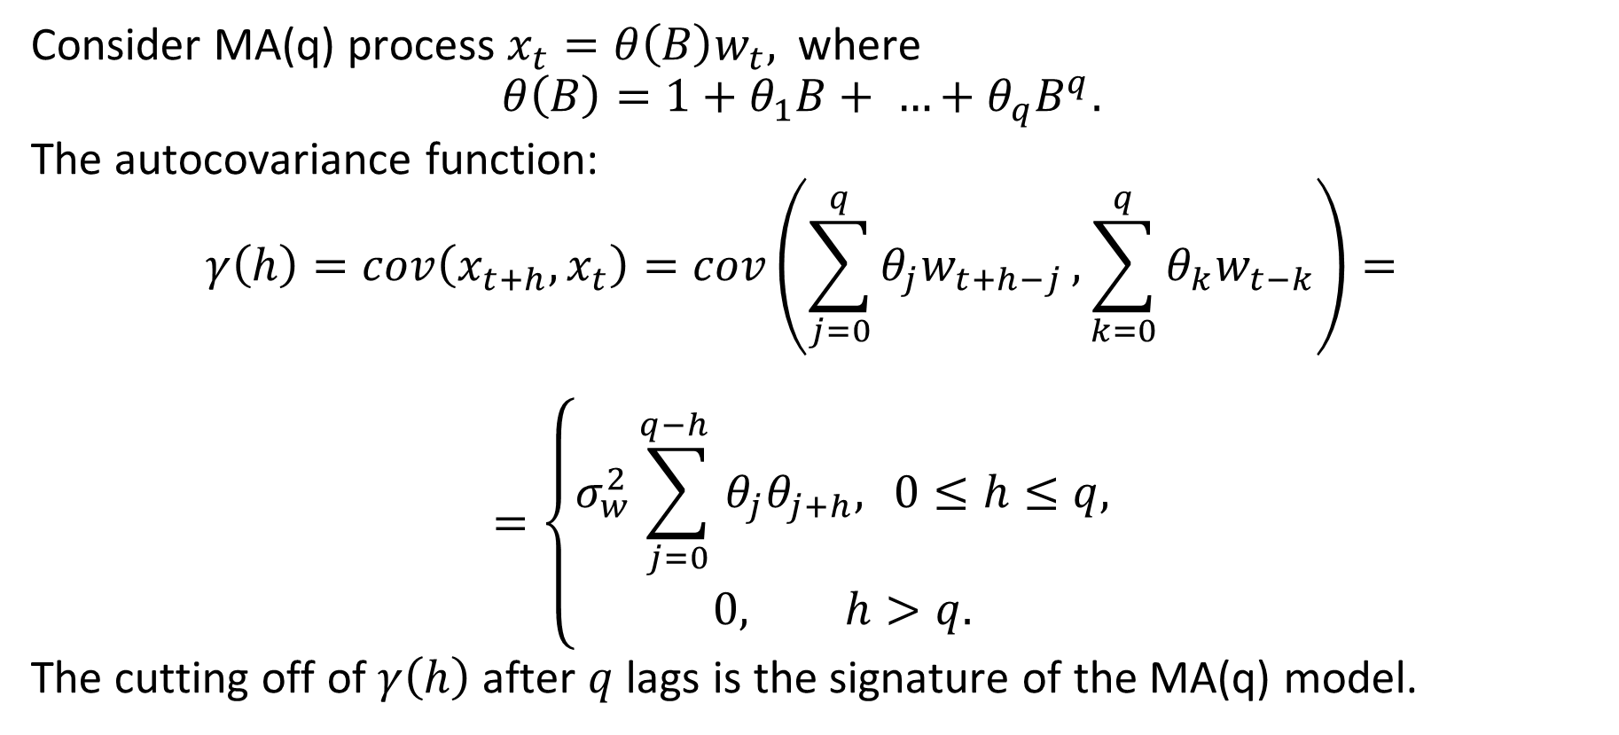
ACF of an MA(q) process
Consider MA(q) process $x_{t}=θ\left(B\right)w_{t},$ where
$$θ\left(B\right)=1+θ_{1}B+ …+θ_{q}B^{q}.$$
The autocovariance function:
$$γ\left(h\right)=cov\left(x_{t+h}, x_{t}\right)=cov\left(\sum_{j=0}^{q}{θ_{j}w_{t+h−j}},\sum_{k=0}^{q}{θ_{k}w_{t−k}}\right)=$$
$$=\left\{\begin{aligned}σ_{w}^{2}\sum_{j=0}^{q−h }{θ_{j}θ_{j+h}, } 0≤h≤q, \\ 0, h>q.\end{aligned}\right.$$
The cutting off of $γ\left(h\right)$ after $q$ lags is the signature of the MA(q) model.

Slide 4
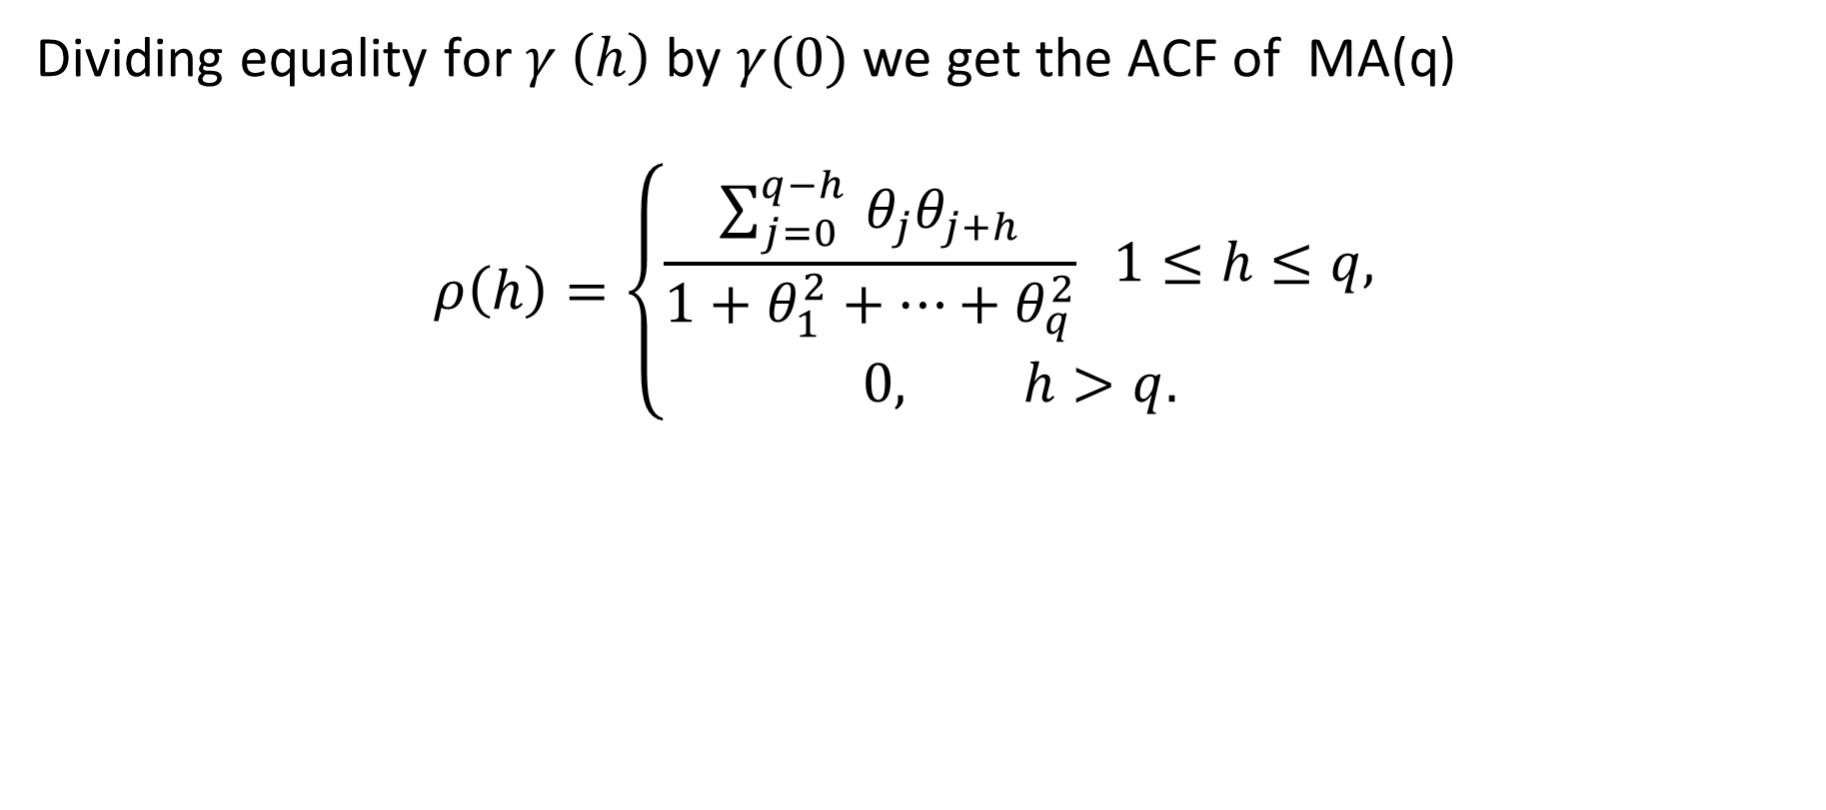
ACF of an MA(q) process
Dividing equality for $γ \left(h\right)$ by $γ(0)$ we get the ACF of MA(q)
$$ρ\left(h\right)=\left\{\begin{aligned}\frac{\sum_{j=0}^{q−h }{θ_{j}θ_{j+h}}}{1+θ_{1}^{2}+…+θ_{q}^{2}} 1≤h≤q, \\ 0, h>q.\end{aligned}\right.$$

Slide 5
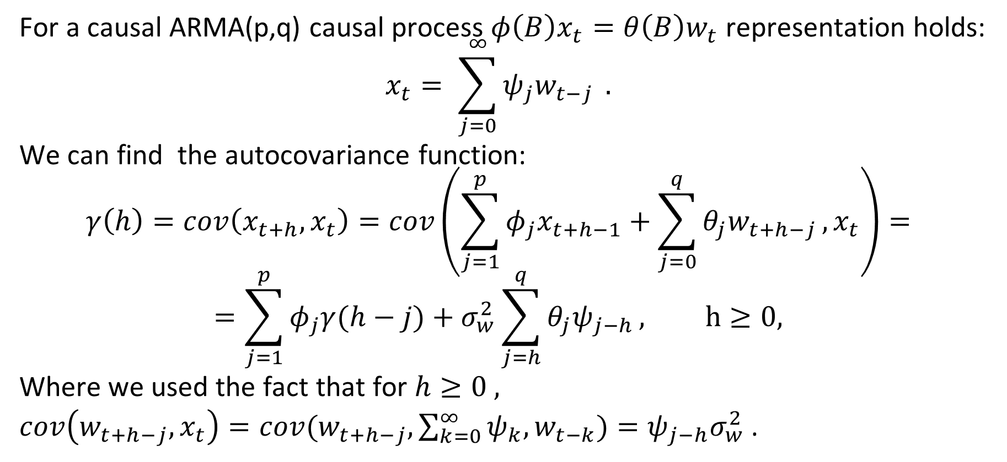
General homogeneous equation for the ACF
For a causal ARMA(p,q) causal process $φ\left(B\right)x_{t}=θ\left(B\right)w_{t}$ representation holds:
$$x_{t}= \sum_{j=0}^{∞}{ψ_{j}w_{t−j} }.$$
We can find the autocovariance function:
$$γ\left(h\right)=cov\left(x_{t+h}, x_{t}\right)=cov\left(\sum_{j=1}^{p}{φ_{j}x_{t+h−1}}+\sum_{j=0}^{q}{θ_{j}w_{t+h−j}},x_{t}\right)=$$
$$=\sum_{j=1}^{p}{φ_{j}γ(h−j)}+σ_{w}^{2}\sum_{j=h}^{q}{θ_{j}ψ_{j−h}}, h≥0,$$
Where we used the fact that for $h≥0 ,$
$cov\left(w_{t+h−j}, x_{t}\right)=cov(w_{t+h−j}, \sum_{k=0}^{∞}{ψ_{k}, w_{t−k})=ψ_{j−h}σ_{w}^{2}}$ .

Slide 6
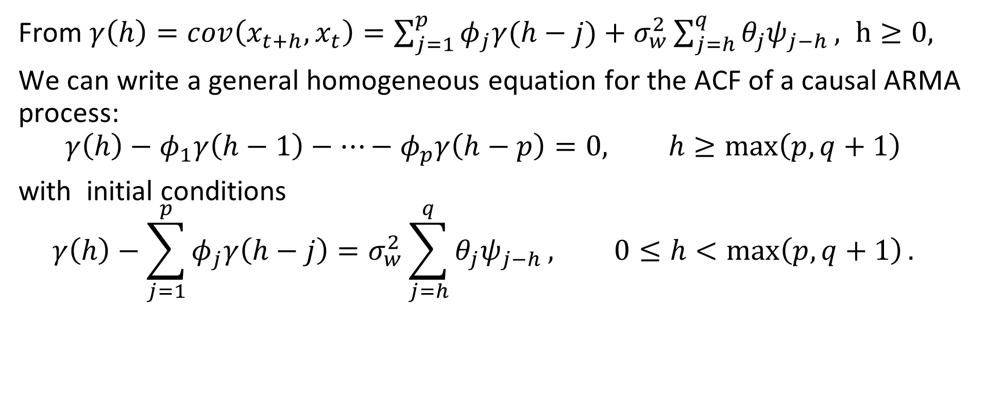
General homogeneous equation for the ACF
From $γ\left(h\right)=cov\left(x_{t+h}, x_{t}\right)=\sum_{j=1}^{p}{φ_{j}γ(h−j)}+σ_{w}^{2}\sum_{j=h}^{q}{θ_{j}ψ_{j−h}}, h≥0,$
We can write a general homogeneous equation for the ACF of a causal ARMA process:
$$γ\left(h\right)−φ_{1}γ\left(h−1\right)−…−φ_{p}γ\left(h−p\right)=0, h≥\max\left(p, q+1\right)$$
with initial conditions
$$γ\left(h\right)−\sum_{j=1}^{p}{φ_{j}γ\left(h−j\right)}=σ_{w}^{2}\sum_{j=h}^{q}{θ_{j}ψ_{j−h}}, 0≤h<\max\left(p,q+1\right).$$

Slide 7
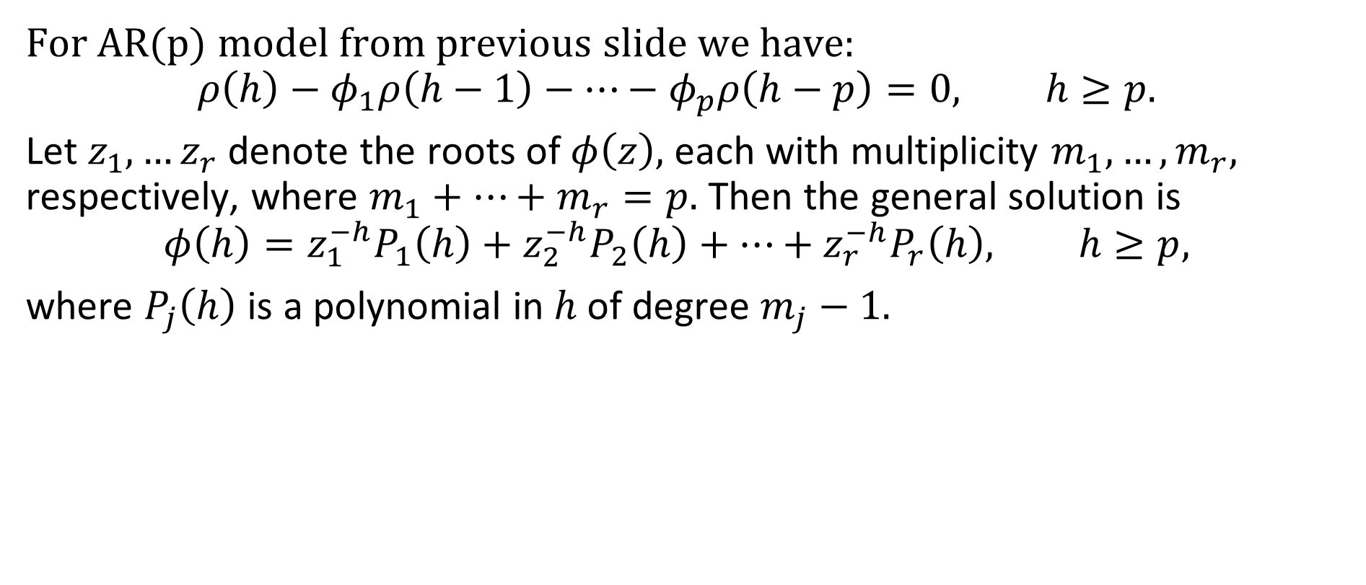
Example 3.13 The ACF of an AR(p)
For AR(p) model from previous slide we have:
$$ρ\left(h\right)−φ_{1}ρ\left(h−1\right)−…−φ_{p}ρ\left(h−p\right)=0, h≥p.$$
Let $z_{1},…z_{r}$ denote the roots of $φ\left(z\right),$ each with multiplicity $m_{1},…, m_{r},$ respectively, where $m_{1}+…+m_{r}=p.$ Then the general solution is
$$φ\left(h\right)=z_{1}^{−h}P_{1}\left(h\right)+z_{2}^{−h}P_{2}\left(h\right)+…+z_{r}^{−h}P_{r}\left(h\right), h≥p,$$
where $P_{j}\left(h\right)$ is a polynomial in $h$of degree $m_{j}−1.$

Slide 8
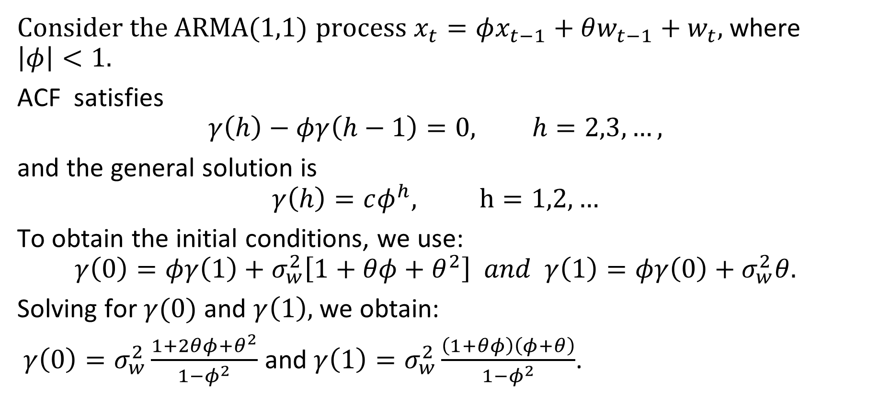
Example 3.14 The ACF of an ARMA(1,1)
Consider the ARMA(1,1) process $x_{t}=φx_{t−1}+θw_{t−1}+w_{t},$ where $\left|φ\right|<1.$
ACF satisfies
$$γ\left(h\right)−φγ\left(h−1\right)=0, h=2,3,…,$$
and the general solution is
$$γ\left(h\right)=cφ^{h}, h=1,2,…$$
To obtain the initial conditions, we use:
$$γ\left(0\right)=φγ\left(1\right)+σ_{w}^{2}\left[1+θφ+θ^{2}\right] and γ\left(1\right)=φγ\left(0\right)+σ_{w}^{2}θ.$$
Solving for $γ(0)$ and $γ\left(1\right),$ we obtain:
$γ\left(0\right)=σ_{w}^{2}\frac{1+2θφ+θ^{2}}{1−φ^{2}}$ and $γ\left(1\right)=σ_{w}^{2}\frac{\left(1+θφ\right)\left(φ+θ\right)}{1−φ^{2}}$.

Slide 9
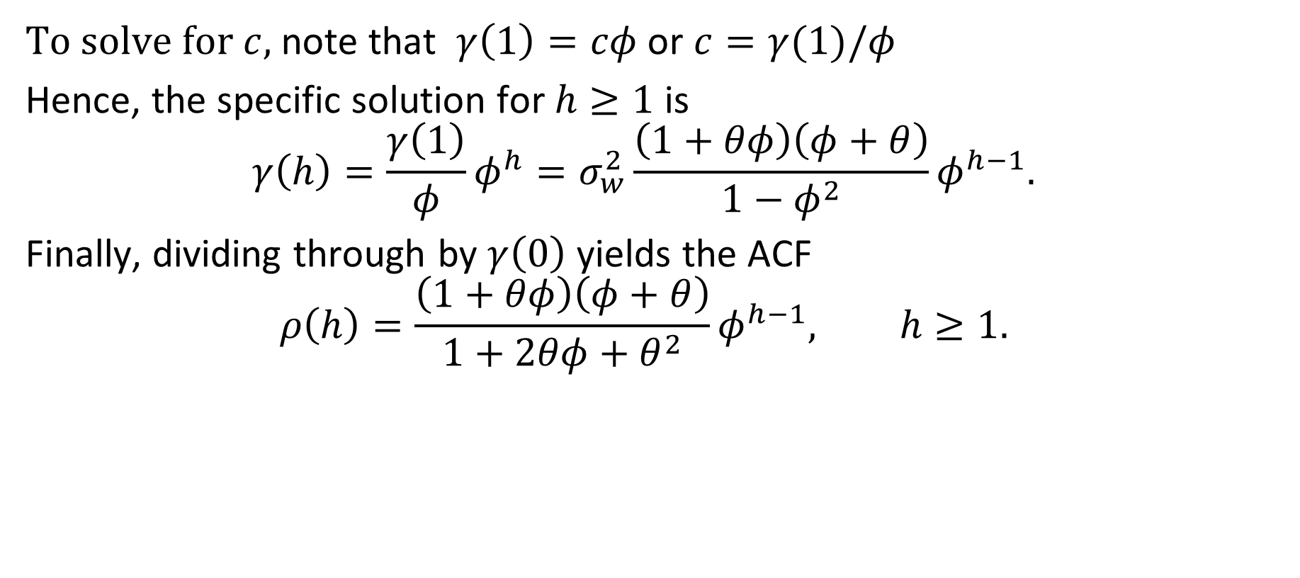
Example 3.14 The ACF of an ARMA(1,1)
To solve for $c,$ note that $γ\left(1\right)=cφ$ or $c=γ(1)/φ$
Hence, the specific solution for $h≥1$ is
$$γ\left(h\right)=\frac{γ\left(1\right)}{φ}φ^{h}=σ_{w}^{2}\frac{\left(1+θφ\right)\left(φ+θ\right)}{1−φ^{2}}φ^{h−1}.$$
Finally, dividing through by $γ\left(0\right)$ yields the ACF
$$ρ\left(h\right)=\frac{\left(1+θφ\right)\left(φ+θ\right)}{1+2θφ+θ^{2}}φ^{h−1}, h≥1.$$

Slide 10
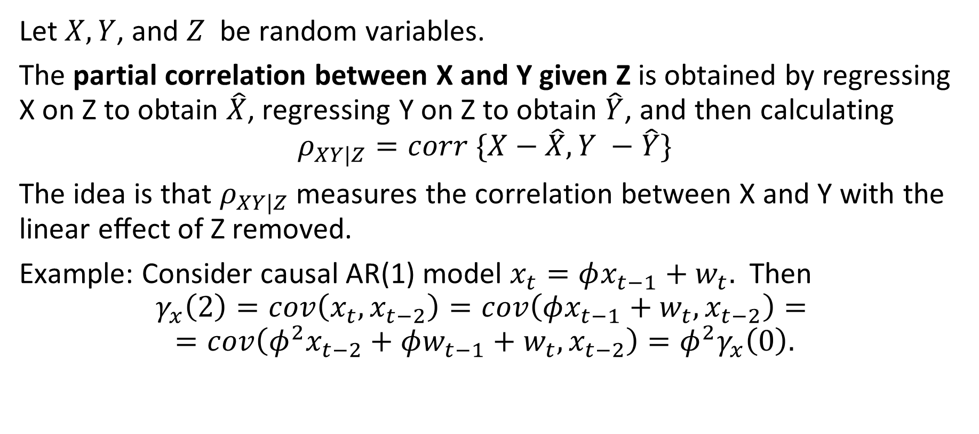
The partial Autocorrelation Function (PACF)
Let $X, Y$, and $Z$ be random variables.
The partial correlation between X and Y given Z is obtained by regressing X on Z to obtain $\hat{X}$, regressing Y on Z to obtain $\hat{Y}$, and then calculating
$$ρ_{XY|Z}=corr \{X−\hat{X}, Y −\hat{Y}\}$$
The idea is that $ρ_{XY|Z}$ measures the correlation between X and Y with the linear eﬀect of Z removed.
Example: Consider causal AR(1) model $x_{t}=φx_{t−1}+w_{t}.$ Then
$$γ_{x}\left(2\right)=cov\left(x_{t}, x_{t−2}\right)=cov\left(φx_{t−1}+w_{t}, x_{t−2}\right)=$$
$$=cov\left(φ^{2}x_{t−2}+φw_{t−1}+w_{t}, x_{t−2}\right)=φ^{2}γ_{x}\left(0\right).$$

Slide 11
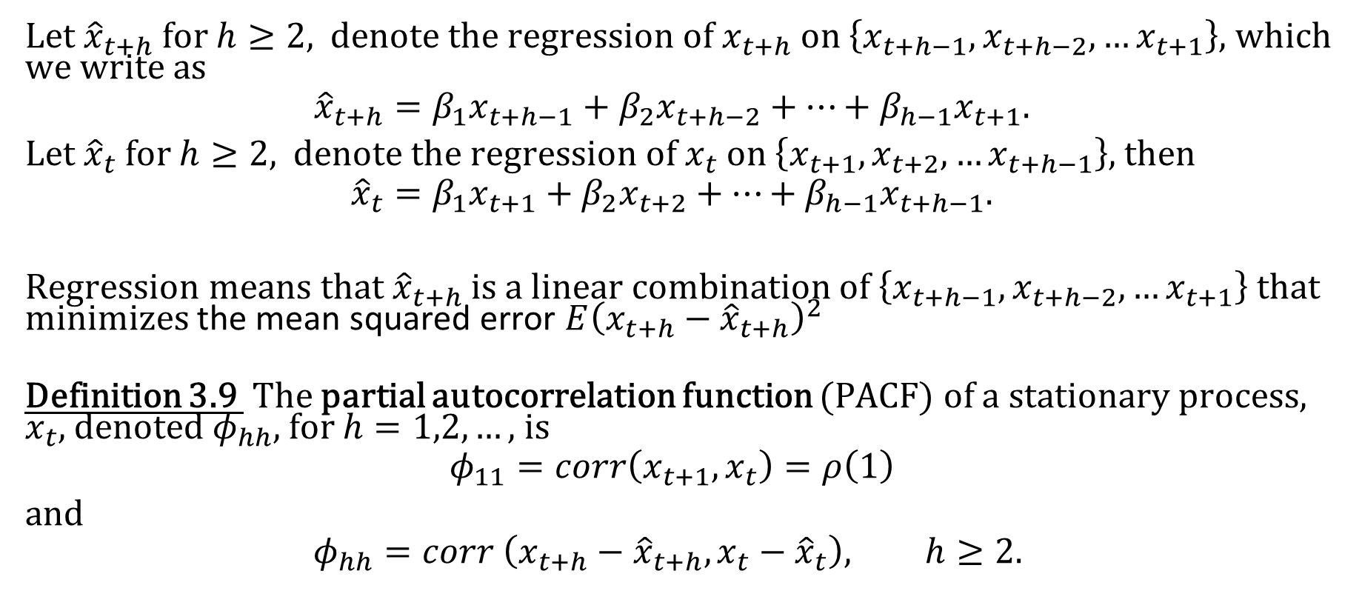
The partial Autocorrelation Function (PACF)
Let ${\hat{x}}_{t+h}$ for $h≥2,$ denote the regression of $x_{t+h}$ on $\left\{x_{t+h−1}, x_{t+h−2},…x_{t+1}\right\},$ which we write as
$${\hat{x}}_{t+h}=β_{1}x_{t+h−1}+β_{2}x_{t+h−2}+…+β_{h−1}x_{t+1}.$$
Let ${\hat{x}}_{t}$ for $h≥2,$ denote the regression of $x_{t}$ on $\left\{x_{t+1}, x_{t+2},…x_{t+h−1}\right\},$ then
$${\hat{x}}_{t}=β_{1}x_{t+1}+β_{2}x_{t+2}+…+β_{h−1}x_{t+h−1}.$$
Regression means that ${\hat{x}}_{t+h}$ is a linear combination of $\left\{x_{t+h−1}, x_{t+h−2},…x_{t+1}\right\}$ that minimizes the mean squared error $E{\left(x_{t+h}−{\hat{x}}_{t+h}\right)}^{2}$
Definition 3.9 The partial autocorrelation function (PACF) of a stationary process, $x_{t}$, denoted $φ_{hh}$, for $h=1,2,…,$ is
$$φ_{11}=corr\left(x_{t+1}, x_{t}\right)=ρ\left(1\right)$$
and
$$φ_{hh}=corr \left(x_{t+h}−{\hat{x}}_{t+h}, x_{t}−{\hat{x}}_{t}\right), h≥2.$$

Slide 12
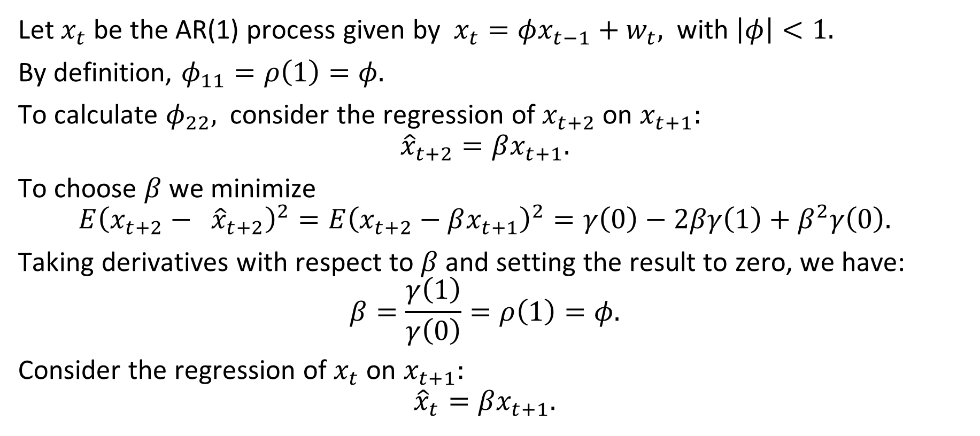
Example 3.15 The PACF of an AR(1)
Let $x_{t}$ be the AR(1) process given by $x_{t}=φx_{t−1}+w_{t},$ with $\left|φ\right|<1.$
By definition, $φ_{11}=ρ\left(1\right)=φ.$
To calculate $φ_{22},$ consider the regression of $x_{t+2}$ on $x_{t+1}:$
$${\hat{x}}_{t+2}=βx_{t+1}.$$
To choose $β$ we minimize
$$E{\left(x_{t+2}− {\hat{x}}_{t+2}\right)}^{2}=E{\left(x_{t+2}−βx_{t+1}\right)}^{2}=γ\left(0\right)−2βγ\left(1\right)+β^{2}γ\left(0\right).$$
Taking derivatives with respect to $β$ and setting the result to zero, we have:
$$β=\frac{γ\left(1\right)}{γ\left(0\right)}=ρ\left(1\right)=φ.$$
Consider the regression of $x_{t}$ on $x_{t+1}:$ $${\hat{x}}_{t}=βx_{t+1}.$$

Slide 13
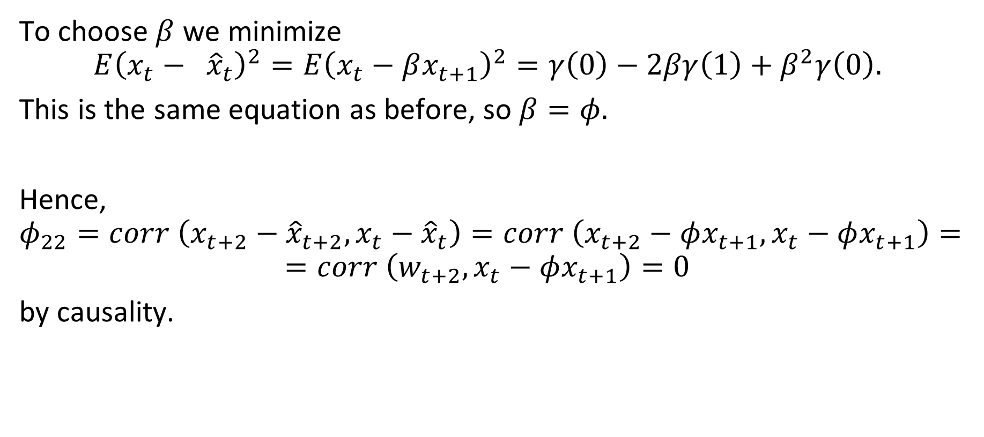
Example 3.15 The PACF of an AR(1)(continued)
To choose $β$ we minimize
$$E{\left(x_{t}− {\hat{x}}_{t}\right)}^{2}=E{\left(x_{t}−βx_{t+1}\right)}^{2}=γ\left(0\right)−2βγ\left(1\right)+β^{2}γ\left(0\right).$$
This is the same equation as before, so $β=φ.$
Hence,
$$φ_{22}=corr \left(x_{t+2}−{\hat{x}}_{t+2}, x_{t}−{\hat{x}}_{t}\right)=corr \left(x_{t+2}−φx_{t+1}, x_{t}−φx_{t+1}\right)=$$
$$=corr \left(w_{t+2}, x_{t}−φx_{t+1}\right)=0$$
by causality.

Slide 14
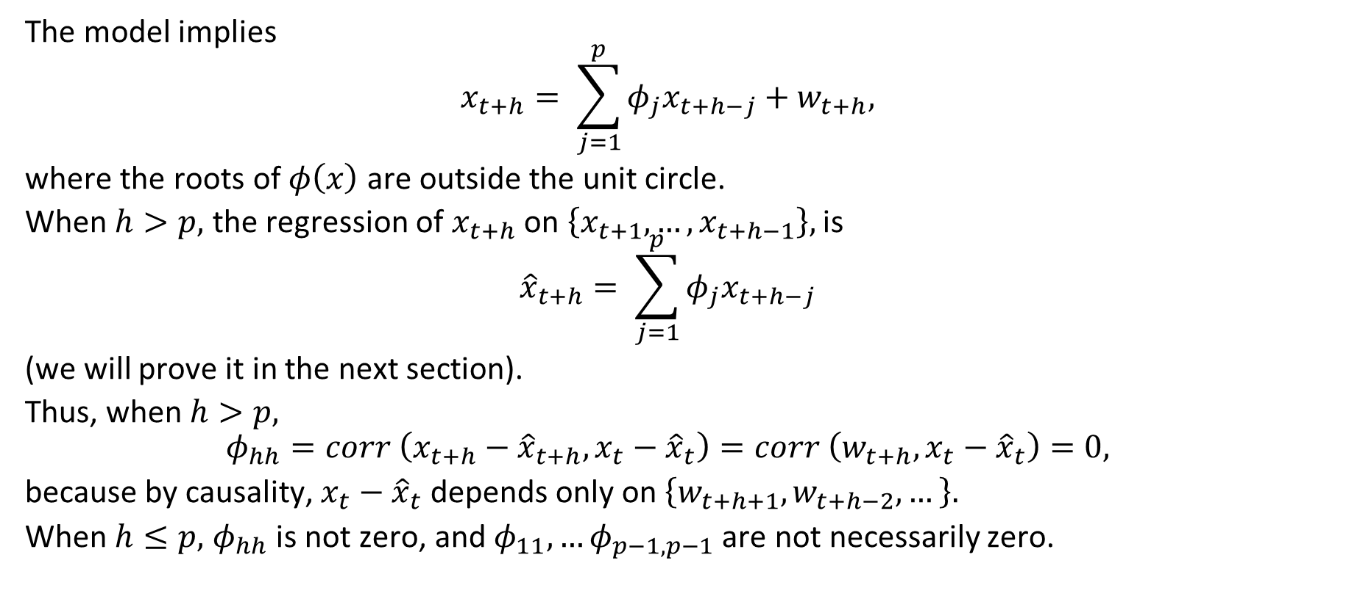
Example 3.16 The PACF of an AR(p)
The model implies
$$x_{t+h}= \sum_{j=1}^{p}{φ_{j}x_{t+h−j}}+w_{t+h},$$
where the roots of $φ\left(x\right)$ are outside the unit circle.
When $h>p,$ the regression of $x_{t+h}$ on $\left\{x_{t+1},…, x_{t+h−1}\right\},$ is
$${\hat{x}}_{t+h}= \sum_{j=1}^{p}{φ_{j}x_{t+h−j}}$$
(we will prove it in the next section).
Thus, when $h>p,$
$$φ_{hh}=corr \left(x_{t+h}−{\hat{x}}_{t+h}, x_{t}−{\hat{x}}_{t}\right)=corr \left(w_{t+h}, x_{t}−{\hat{x}}_{t}\right)=0,$$
because by causality, $x_{t}−{\hat{x}}_{t}$ depends only on $\left\{w_{t+h+1}, w_{t+h−2},…\right\}.$
When $h≤p,$ $φ_{hh}$ is not zero, and $φ_{11},…φ_{p−1, p−1}$ are not necessarily zero.

Slide 15
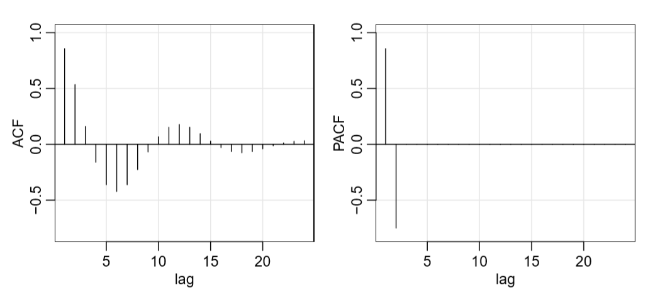
Example 3.16 The PACF of an AR(p)(continued)
The figure shows the ACF and the PACF of the AR(2) model:
R code:
ACF = ARMAacf(ar=c(1.5,-.75), ma=0, 24)[-1]
PACF = ARMAacf(ar=c(1.5,-.75), ma=0, 24, pacf=TRUE)
par(mfrow=c(1,2)) plot(ACF, type="h", xlab="lag", ylim=c(-.8,1)); abline(h=0)
plot(PACF, type="h", xlab="lag", ylim=c(-.8,1)); abline(h=0)

Slide 16
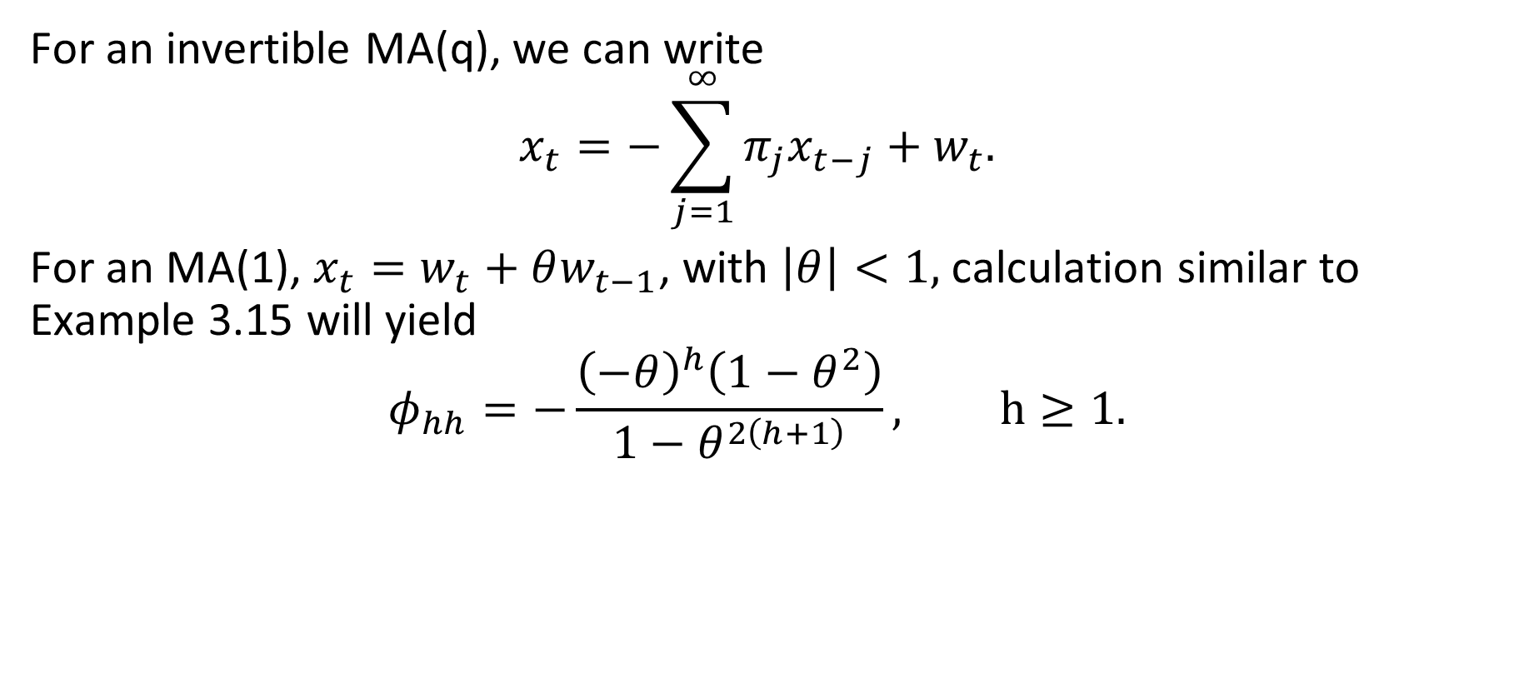
Example 3.17 The PACF of an invertible MA(q)
For an invertible MA(q), we can write
$$x_{t}=−\sum_{j=1}^{∞}{π_{j}x_{t−j}}+w_{t}.$$
For an MA(1), $x_{t}=w_{t}+θw_{t−1}$, with $\left|θ\right|<1,$ calculation similar to Example 3.15 will yield
$$φ_{hh}=−\frac{{\left(−θ\right)}^{h}\left(1−θ^{2}\right)}{1−θ^{2\left(h+1\right)}}, h≥1.$$

Slide 17
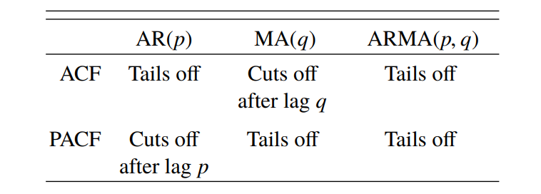
Summary
The PACF for MA models behaves much like the ACF for AR models. Also, the PACF for AR models behaves much like the ACF for MA models. Because an invertible ARMA model has an infinite AR representation, the PACF will not cut off .

Slide 18
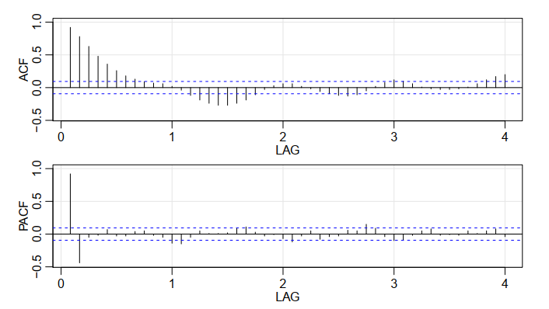
Example 3.18 Preliminary Analysis of the Recruitment Series
The ACF and the PACF given in
Figure are consistent with the
behavior of an AR(2). The ACF has
cycles corresponding roughly to a
12-month period, and the PACF has
large values for h = 1; 2 and then
is essentially zero for higher order lags. These results suggest
that a second-order (p = 2) autoregressive model might provide
a good fit.
acf2(rec, 48) # will produce values and a graphic
(regr = ar.ols(rec, order=2, demean=FALSE, intercept=TRUE))
regr$asy.se.coef # standard errors of the estimates

Slide 19
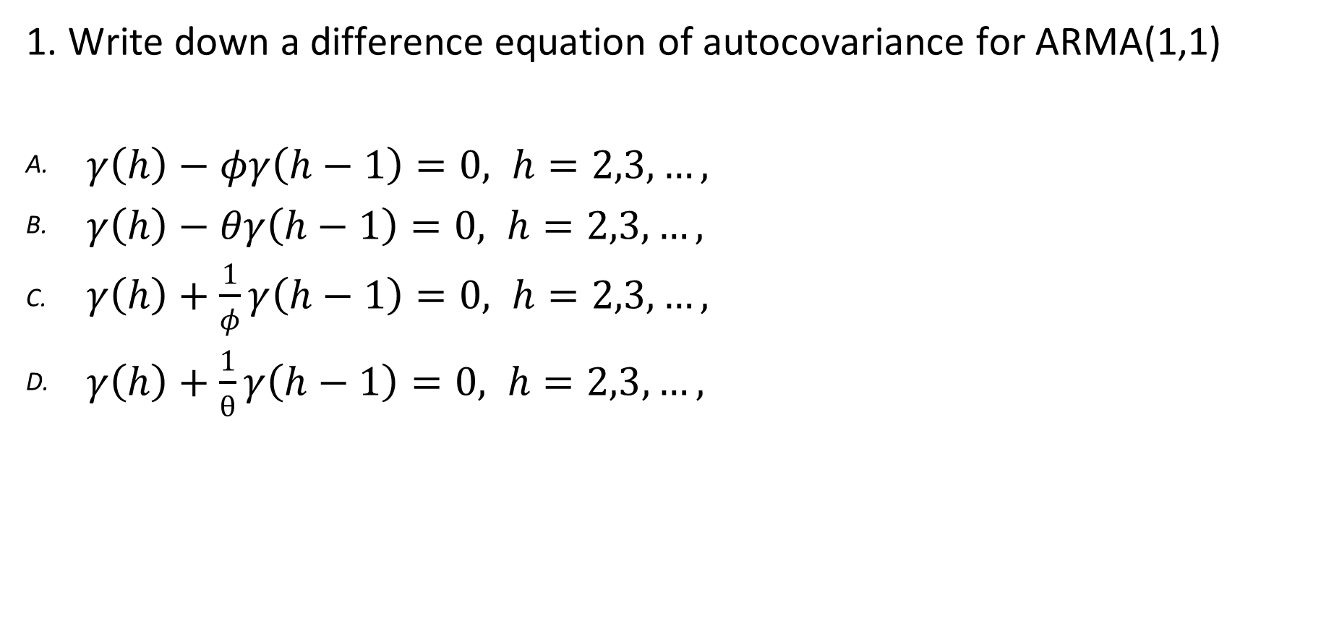
PACF Quiz. Qualitative.
1. Write down a difference equation of autocovariance for ARMA(1,1)
$γ\left(h\right)−φγ\left(h−1\right)=0, h=2,3,…,$
$γ\left(h\right)−θγ\left(h−1\right)=0, h=2,3,…,$
$γ\left(h\right)+\frac{1}{φ}γ\left(h−1\right)=0, h=2,3,…,$
$γ\left(h\right)+\frac{1}{θ}γ\left(h−1\right)=0, h=2,3,…,$

Slide 20
PACF Quiz. Qualitative.
2. What is PACF?
Princeton Area Community Foundation
Partial Autocorrelation Function
Polish Arts and Culture Foundation
Performance Assessment and Control Facility

Slide 21
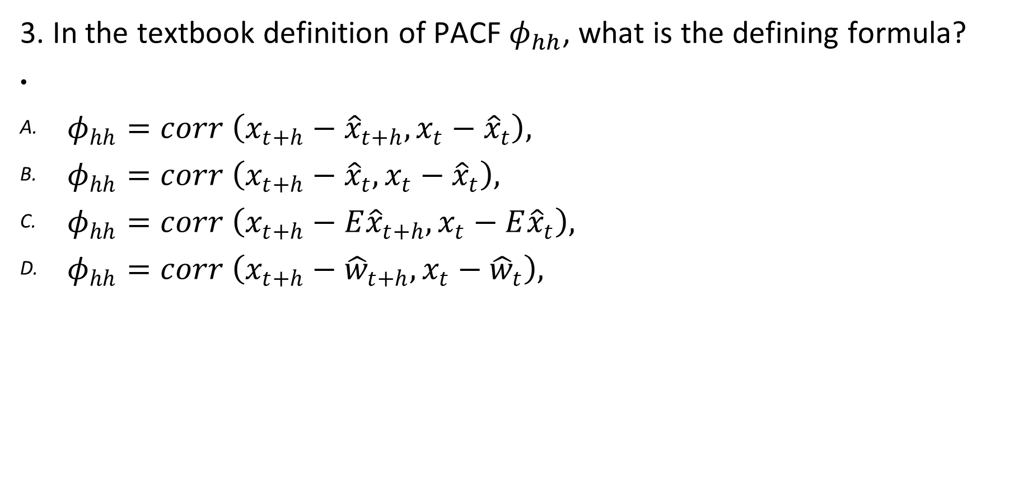
PACF Quiz. Qualitative.
3. In the textbook definition of PACF $φ_{hh}$, what is the defining formula?
$φ_{hh}=corr \left(x_{t+h}−{\hat{x}}_{t+h}, x_{t}−{\hat{x}}_{t}\right),$
$φ_{hh}=corr \left(x_{t+h}−{\hat{x}}_{t}, x_{t}−{\hat{x}}_{t}\right),$
$φ_{hh}=corr \left(x_{t+h}−{E\hat{x}}_{t+h}, x_{t}−E{\hat{x}}_{t}\right),$
$φ_{hh}=corr \left(x_{t+h}−{\hat{w}}_{t+h}, x_{t}−{\hat{w}}_{t}\right),$

Slide 22
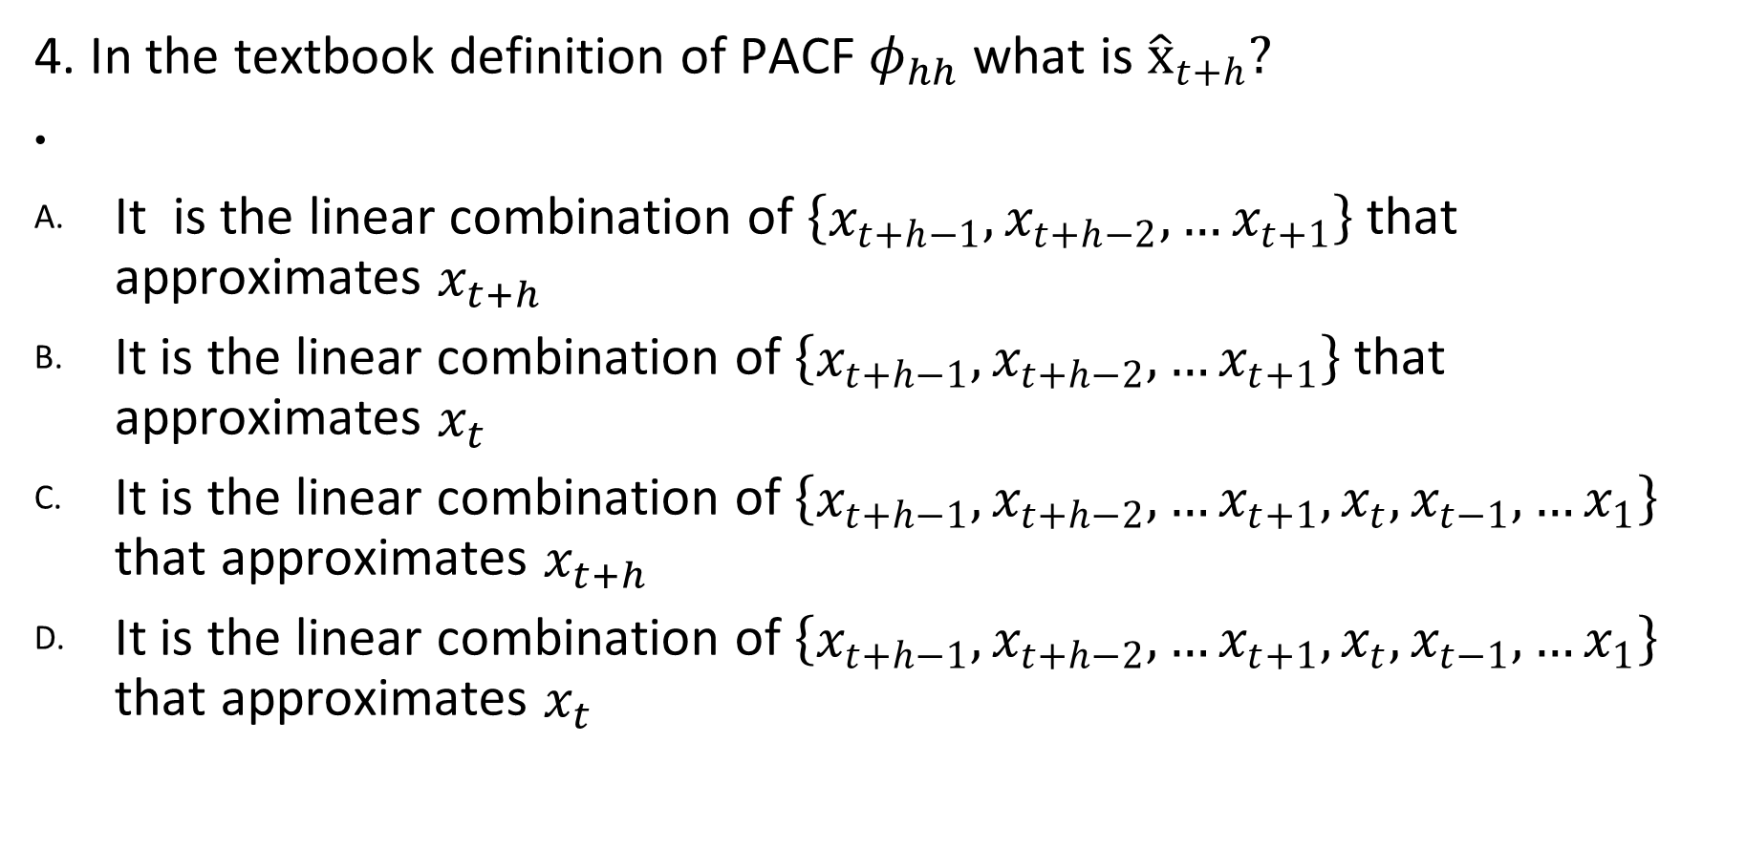
PACF Quiz. Qualitative.
4. In the textbook definition of PACF $φ_{hh}$what is ${\hat{x}}_{t+h}?$
It is the linear combination of $\left\{x_{t+h−1}, x_{t+h−2},…x_{t+1}\right\}$ that approximates $x_{t+h}$
It is the linear combination of $\left\{x_{t+h−1}, x_{t+h−2},…x_{t+1}\right\}$ that approximates $x_{t}$
It is the linear combination of $\left\{x_{t+h−1}, x_{t+h−2},…x_{t+1}, x_{t}, x_{t−1},…x_{1}\right\}$ that approximates $x_{t+h}$
It is the linear combination of $\left\{x_{t+h−1}, x_{t+h−2},…x_{t+1}, x_{t}, x_{t−1},…x_{1}\right\}$ that approximates $x_{t}$

Slide 23
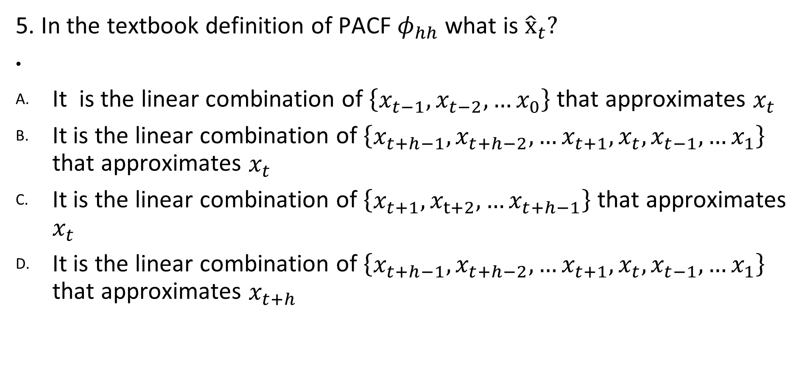
PACF Quiz. Qualitative.
5. In the textbook definition of PACF $φ_{hh}$what is ${\hat{x}}_{t}?$
It is the linear combination of $\left\{x_{t−1}, x_{t−2},…x_{0}\right\}$ that approximates $x_{t}$
It is the linear combination of $\left\{x_{t+h−1}, x_{t+h−2},…x_{t+1}, x_{t}, x_{t−1},…x_{1}\right\}$ that approximates $x_{t}$
It is the linear combination of $\left\{x_{t+1}, x_{t+2},…x_{t+h−1}\right\}$ that approximates $x_{t}$
It is the linear combination of $\left\{x_{t+h−1}, x_{t+h−2},…x_{t+1}, x_{t}, x_{t−1},…x_{1}\right\}$ that approximates $x_{t+h}$

Slide 24
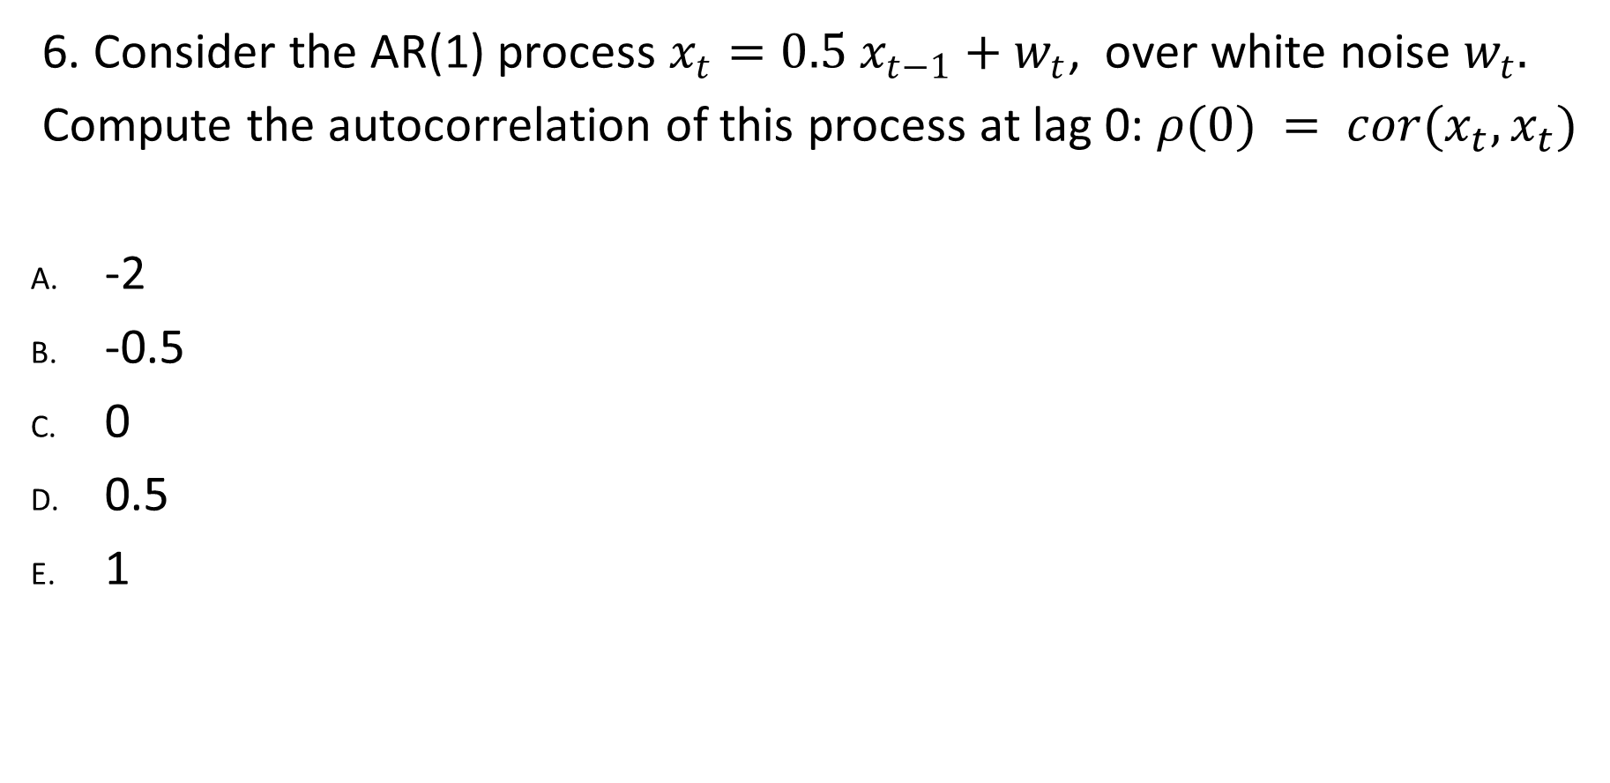
PACF Quiz. Quantitative.
6. Consider the AR(1) process $x_{t}=0.5 x_{t−1}+w_{t}$, over white noise $w_{t}.$
Compute the autocorrelation of this process at lag 0: $ρ(0) = cor(x_{t}, x_{t})$
-2
-0.5
0
0.5
1

Slide 25
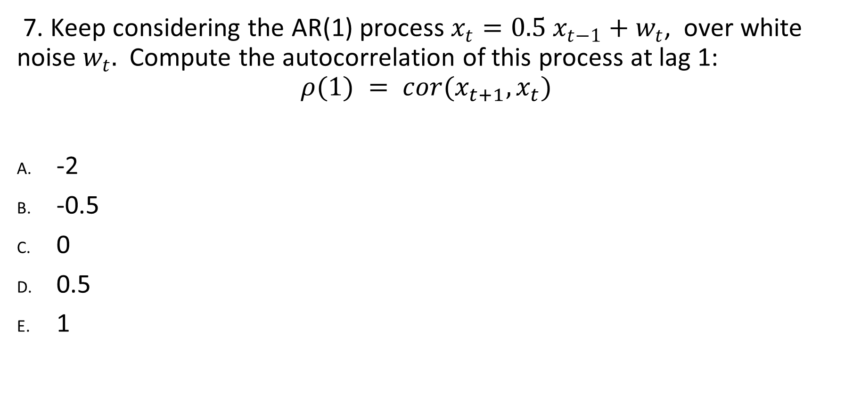
PACF Quiz. Quantitative.
7. Keep considering the AR(1) process $x_{t}=0.5 x_{t−1}+w_{t}$, over white noise $w_{t}.$ Compute the autocorrelation of this process at lag 1:
$$ρ(1) = cor(x_{t+1}, x_{t})$$
-2
-0.5
0
0.5
1

Slide 26
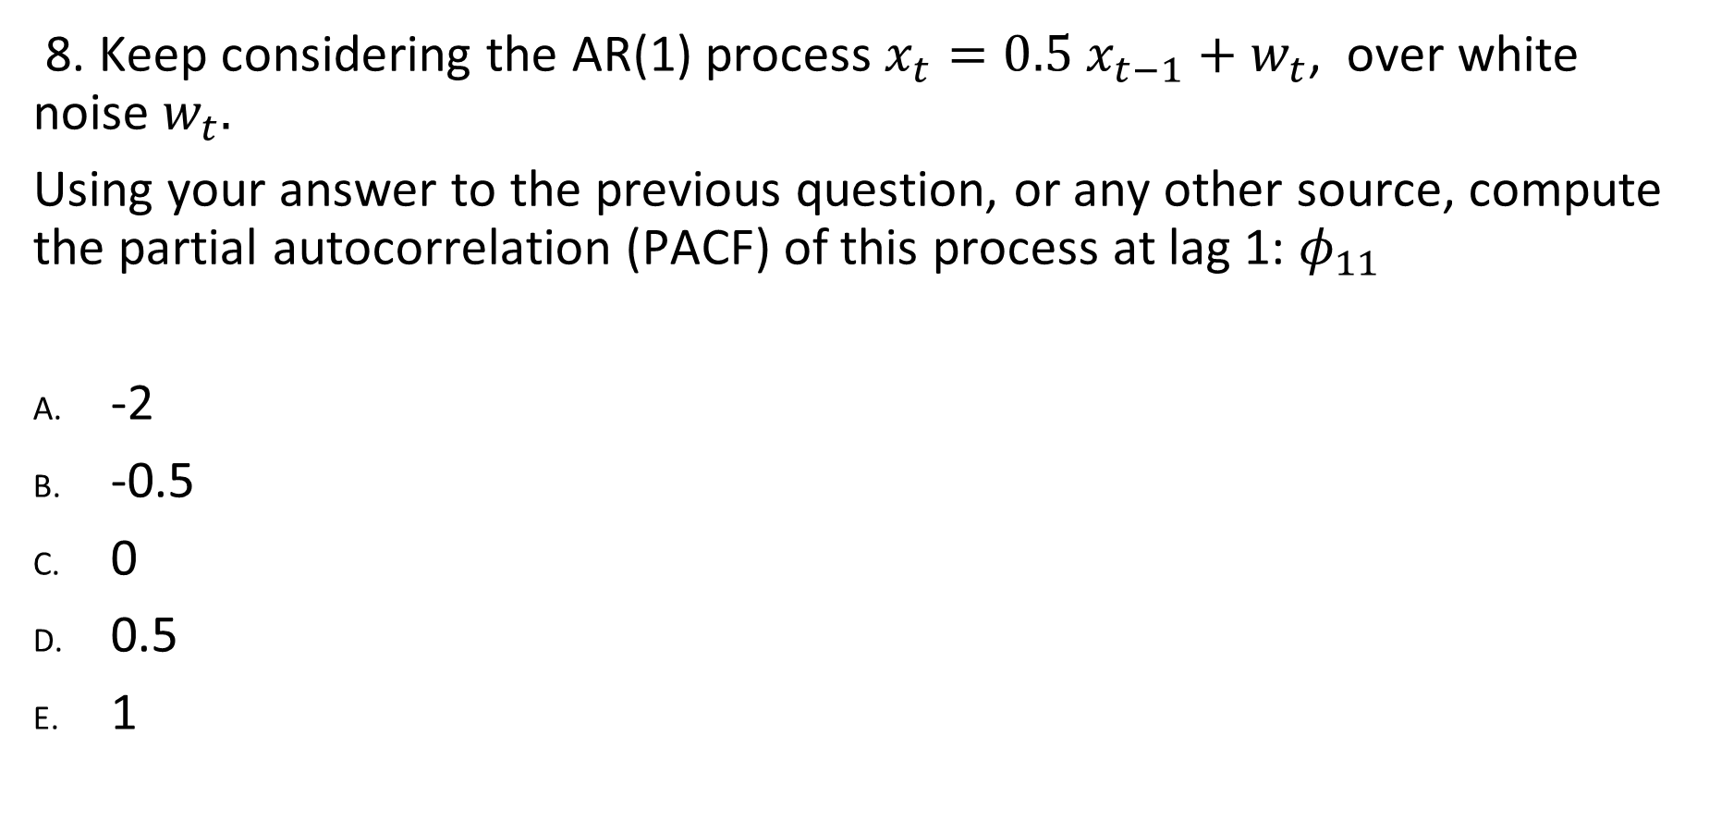
PACF Quiz. Quantitative.
8. Keep considering the AR(1) process $x_{t}=0.5 x_{t−1}+w_{t}$, over white noise $w_{t}.$
Using your answer to the previous question, or any other source, compute the partial autocorrelation (PACF) of this process at lag 1: $φ_{11}$
-2
-0.5
0
0.5
1

Slide 27
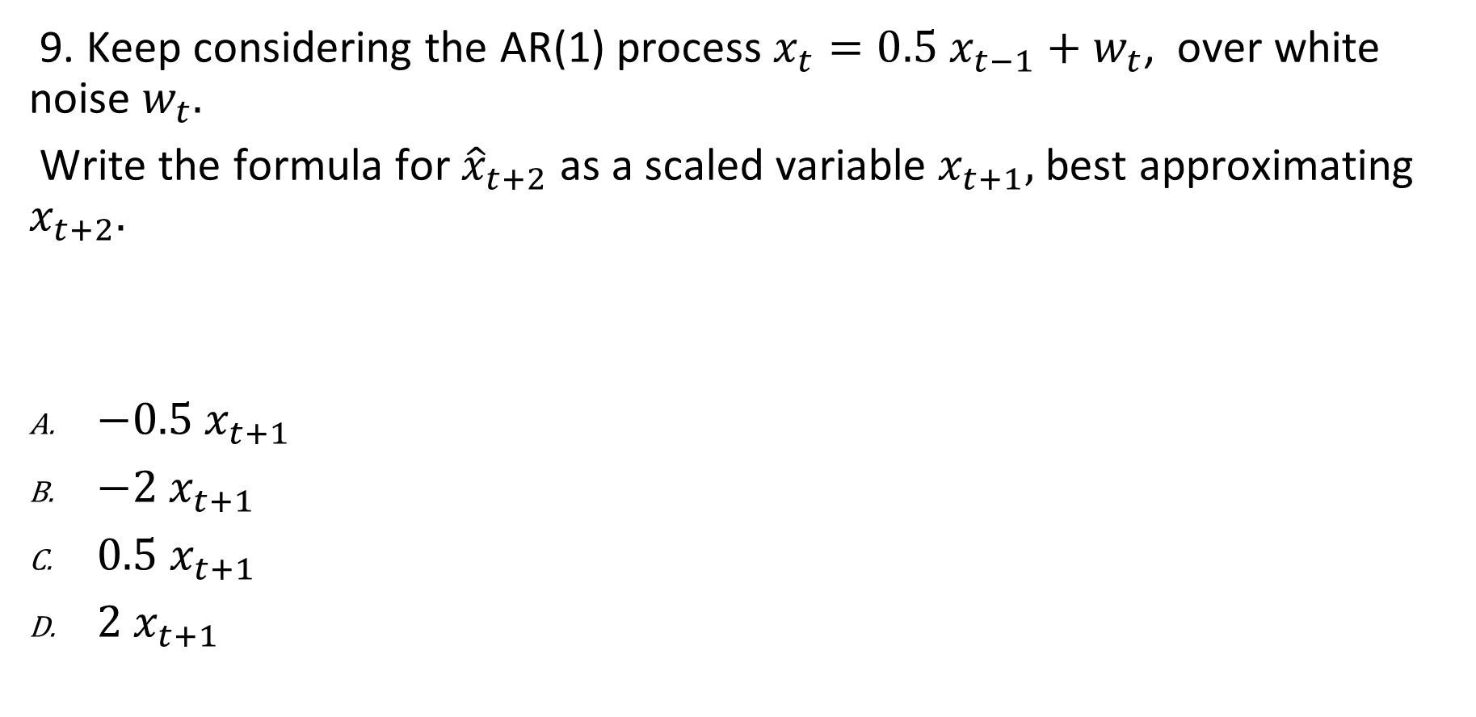
PACF Quiz. Quantitative.
9. Keep considering the AR(1) process $x_{t}=0.5 x_{t−1}+w_{t}$, over white noise $w_{t}.$
Write the formula for ${\hat{x}}_{t+2}$ as a scaled variable $x_{t+1},$best approximating $x_{t+2}.$
${−0.5 x}_{t+1}$
${−2 x}_{t+1}$
${0.5 x}_{t+1}$
${2 x}_{t+1}$

Slide 28
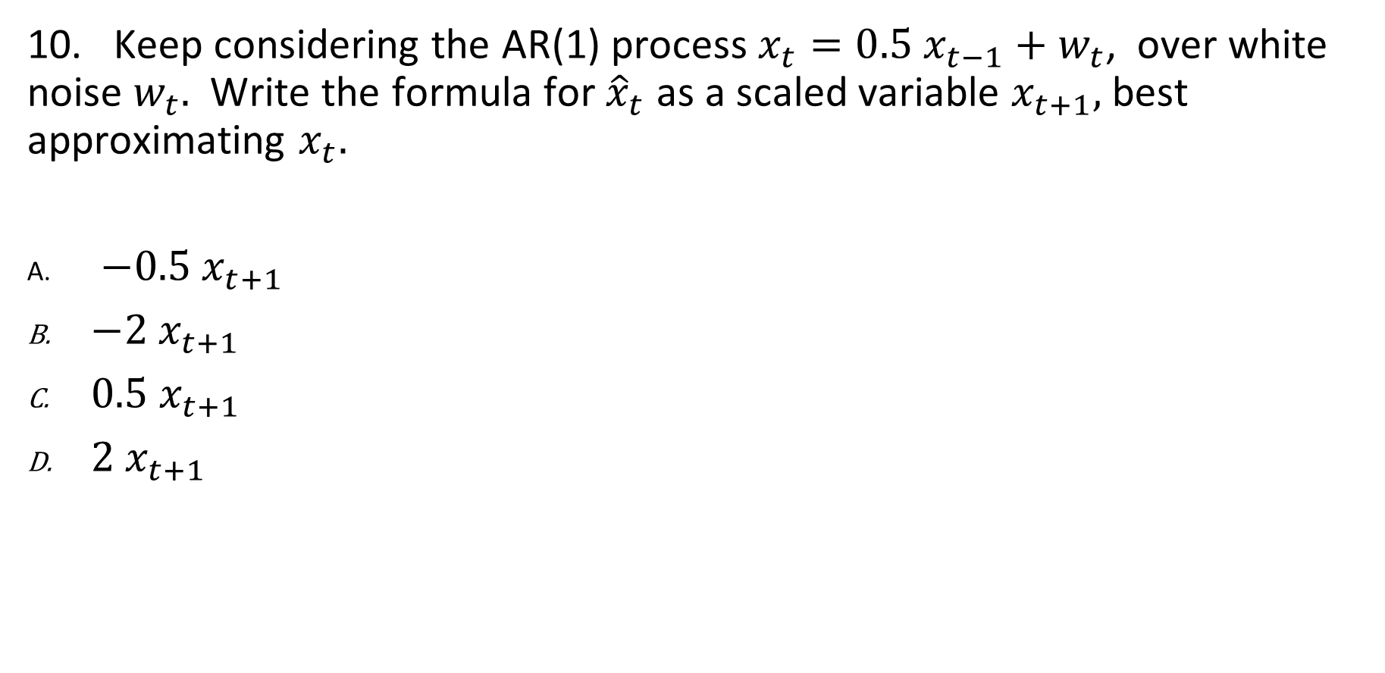
PACF Quiz. Quantitative.
10. Keep considering the AR(1) process $x_{t}=0.5 x_{t−1}+w_{t}$, over white noise $w_{t}.$ Write the formula for ${\hat{x}}_{t}$ as a scaled variable $x_{t+1},$best approximating $x_{t}.$
${−0.5 x}_{t+1}$
${−2 x}_{t+1}$
${0.5 x}_{t+1}$
${2 x}_{t+1}$

Slide 29
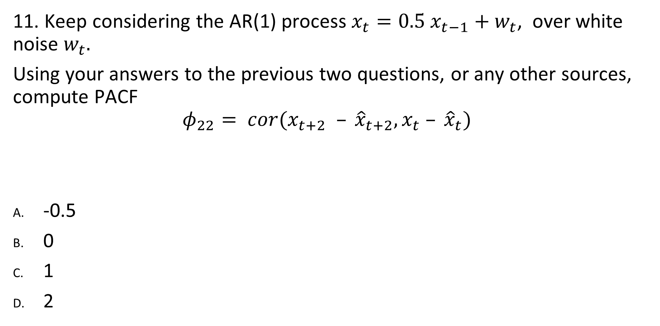
PACF Quiz. Quantitative.
11. Keep considering the AR(1) process $x_{t}=0.5 x_{t−1}+w_{t}$, over white noise $w_{t}.$
Using your answers to the previous two questions, or any other sources, compute PACF
$$φ_{22}= cor(x_{t+2} – {\hat{x}}_{t+2}, x_{t} – {\hat{x}}_{t})$$
-0.5
0
1
2

Slide 30
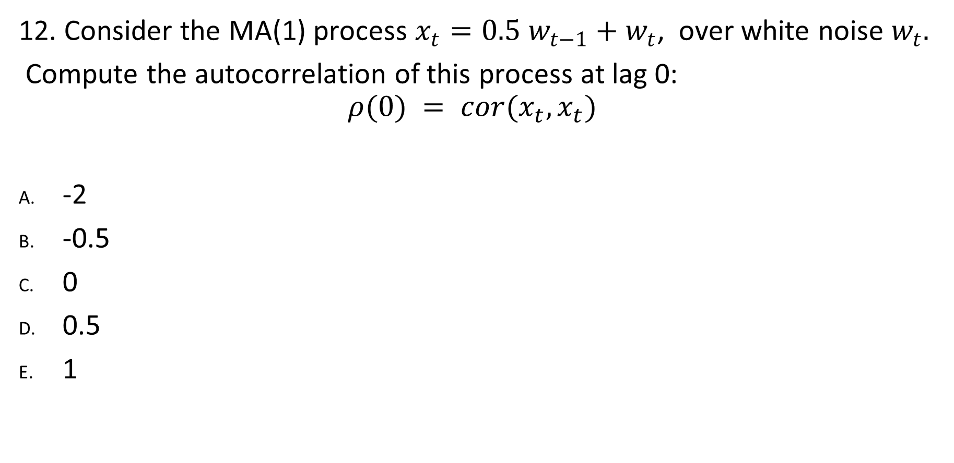
PACF Quiz. Quantitative.
12. Consider the MA(1) process $x_{t}=0.5 w_{t−1}+w_{t}$, over white noise $w_{t}.$
Compute the autocorrelation of this process at lag 0:
$$ρ(0) = cor(x_{t}, x_{t})$$
-2
-0.5
0
0.5
1

Slide 31
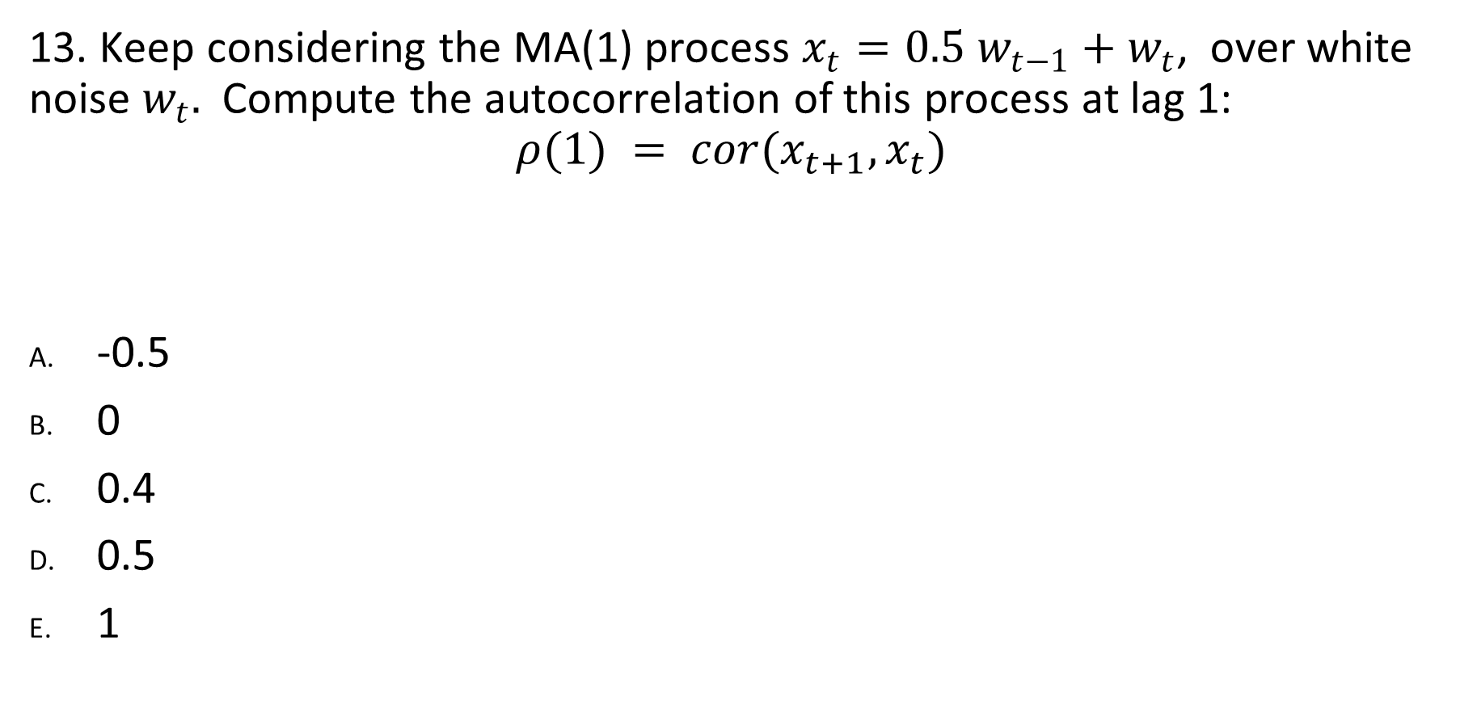
PACF Quiz. Quantitative.
13. Keep considering the MA(1) process $x_{t}=0.5 w_{t−1}+w_{t}$, over white noise $w_{t}.$ Compute the autocorrelation of this process at lag 1:
$$ρ(1) = cor(x_{t+1}, x_{t})$$
-0.5
0
0.4
0.5
1

Slide 32
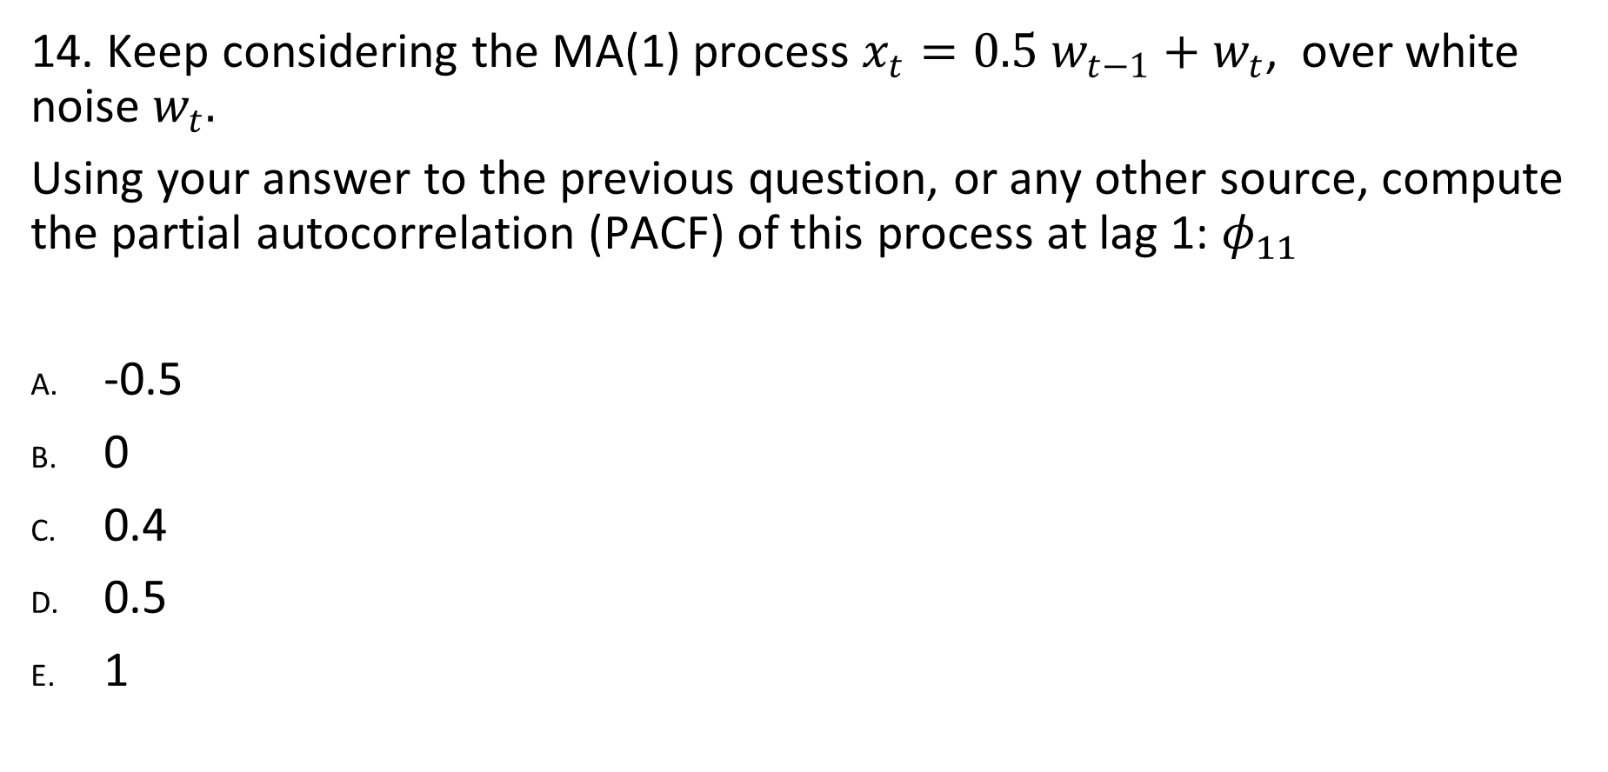
PACF Quiz. Quantitative.
14. Keep considering the MA(1) process $x_{t}=0.5 w_{t−1}+w_{t}$, over white noise $w_{t}.$
Using your answer to the previous question, or any other source, compute the partial autocorrelation (PACF) of this process at lag 1: $φ_{11}$
-0.5
0
0.4
0.5
1

Slide 33
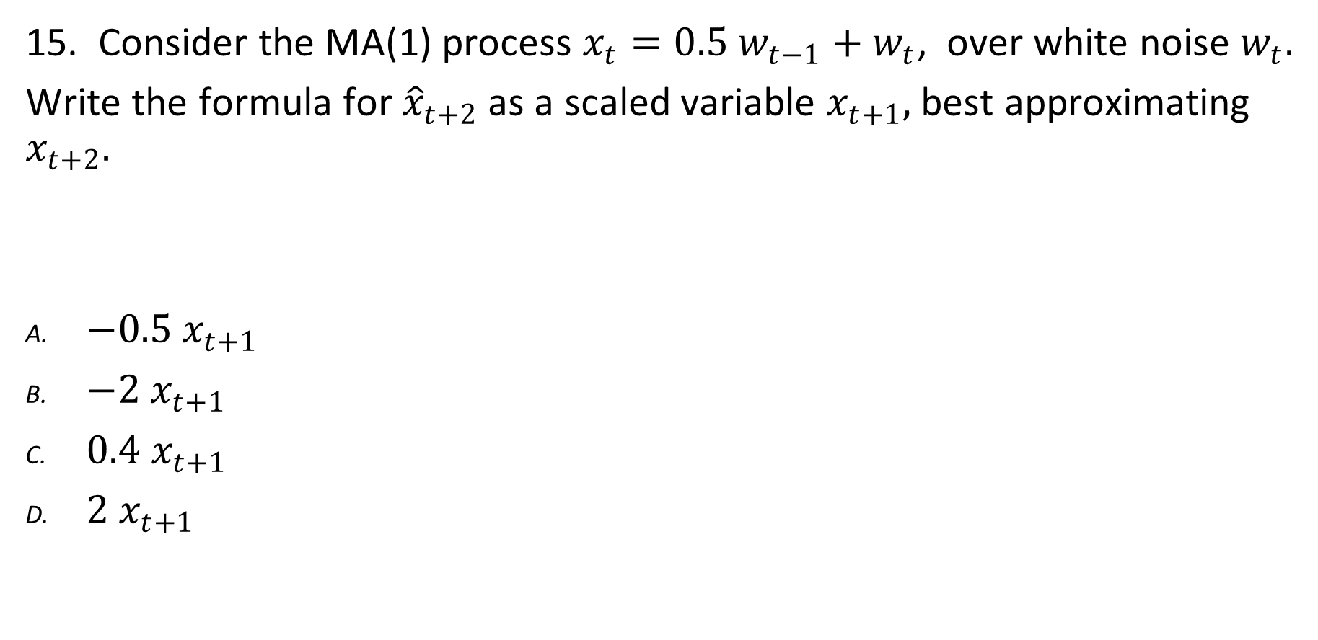
PACF Quiz. Quantitative.
15. Consider the MA(1) process $x_{t}=0.5 w_{t−1}+w_{t}$, over white noise $w_{t}.$
Write the formula for ${\hat{x}}_{t+2}$ as a scaled variable $x_{t+1},$best approximating $x_{t+2}.$
${−0.5 x}_{t+1}$
${−2 x}_{t+1}$
${0.4 x}_{t+1}$
${2 x}_{t+1}$

Slide 34
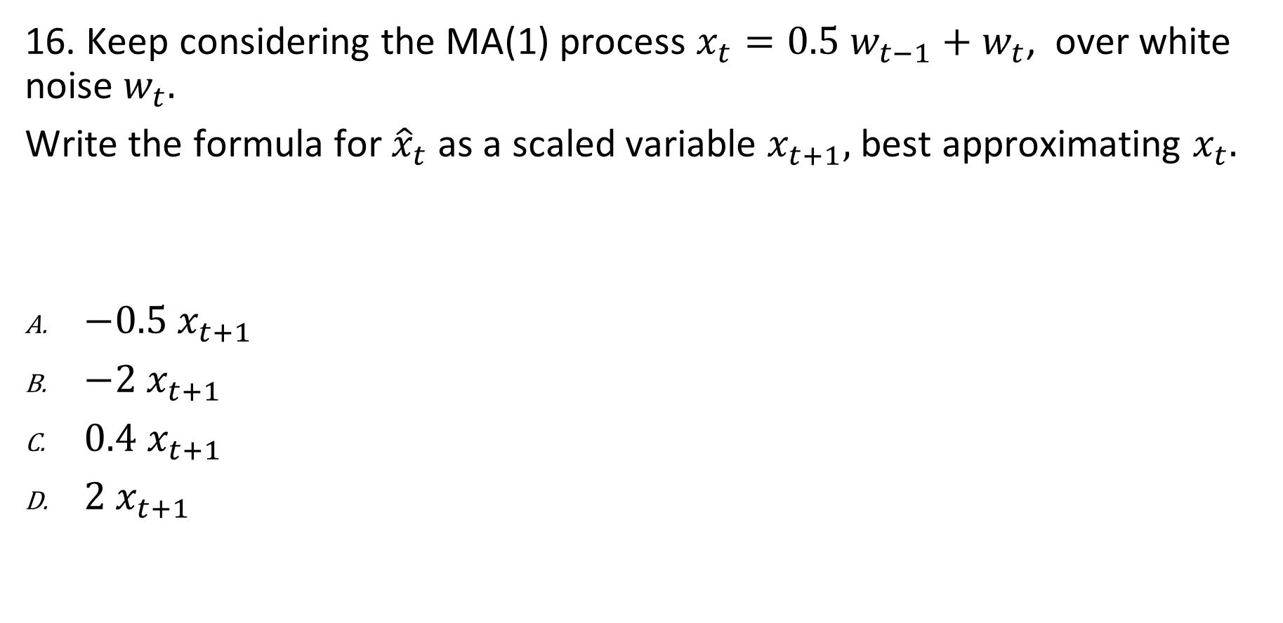
PACF Quiz. Quantitative.
16. Keep considering the МА(1) process $x_{t}=0.5 w_{t−1}+w_{t}$, over white noise $w_{t}.$
Write the formula for ${\hat{x}}_{t}$ as a scaled variable $x_{t+1},$best approximating $x_{t}.$
${−0.5 x}_{t+1}$
${−2 x}_{t+1}$
${0.4 x}_{t+1}$
${2 x}_{t+1}$

Slide 35
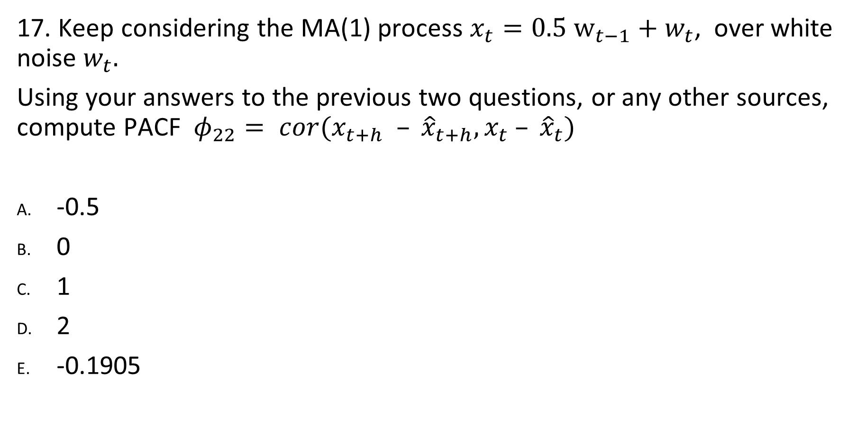
PACF Quiz. Quantitative.
17. Keep considering the MA(1) process $x_{t}=0.5 w_{t−1}+w_{t}$, over white noise $w_{t}.$
Using your answers to the previous two questions, or any other sources, compute PACF$φ_{22}= cor(x_{t+h} – {\hat{x}}_{t+h}, x_{t} – {\hat{x}}_{t})$
-0.5
0
1
2
-0.1905

Slide 36
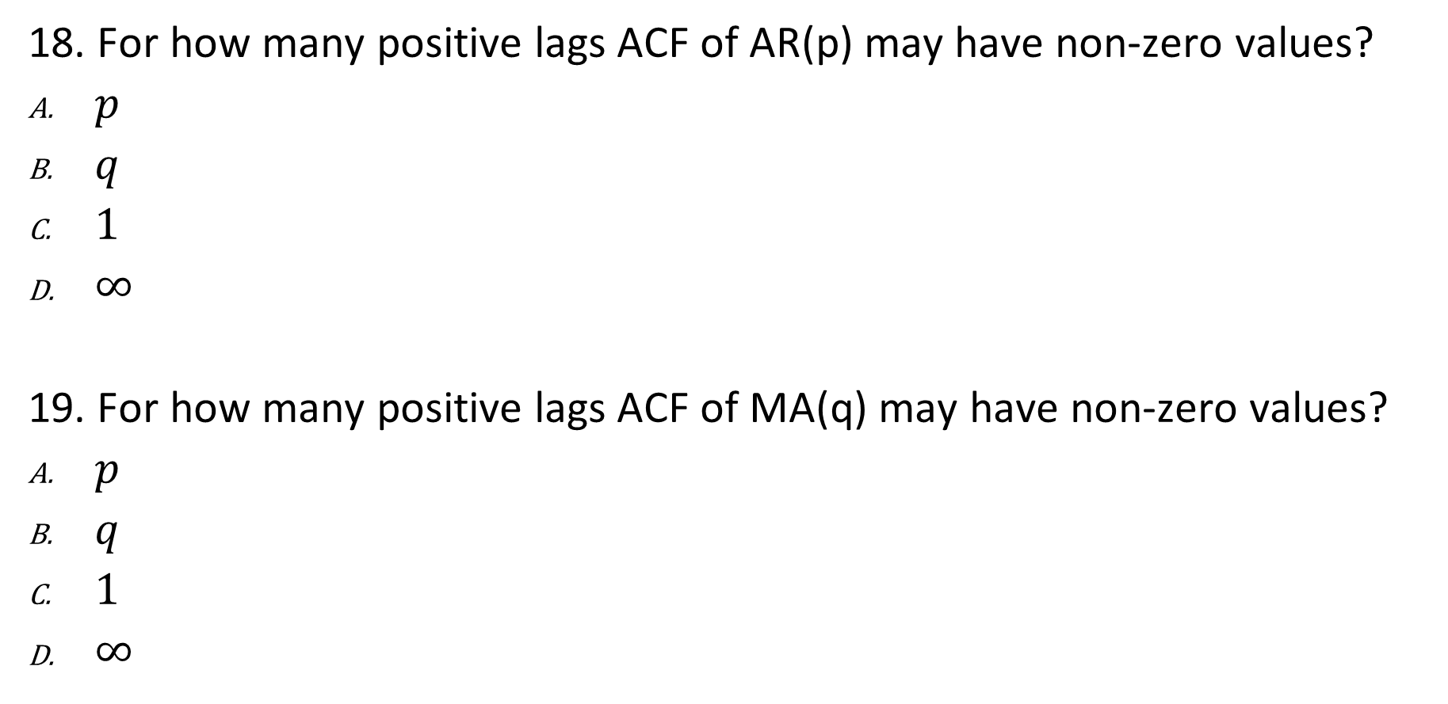
PACF Quiz.
18. For how many positive lags ACF of AR(p) may have non-zero values?
$p$
$q$
$1$
$∞$
19. For how many positive lags ACF of MA(q) may have non-zero values?
$p$
$q$
$1$
$∞$

Slide 37
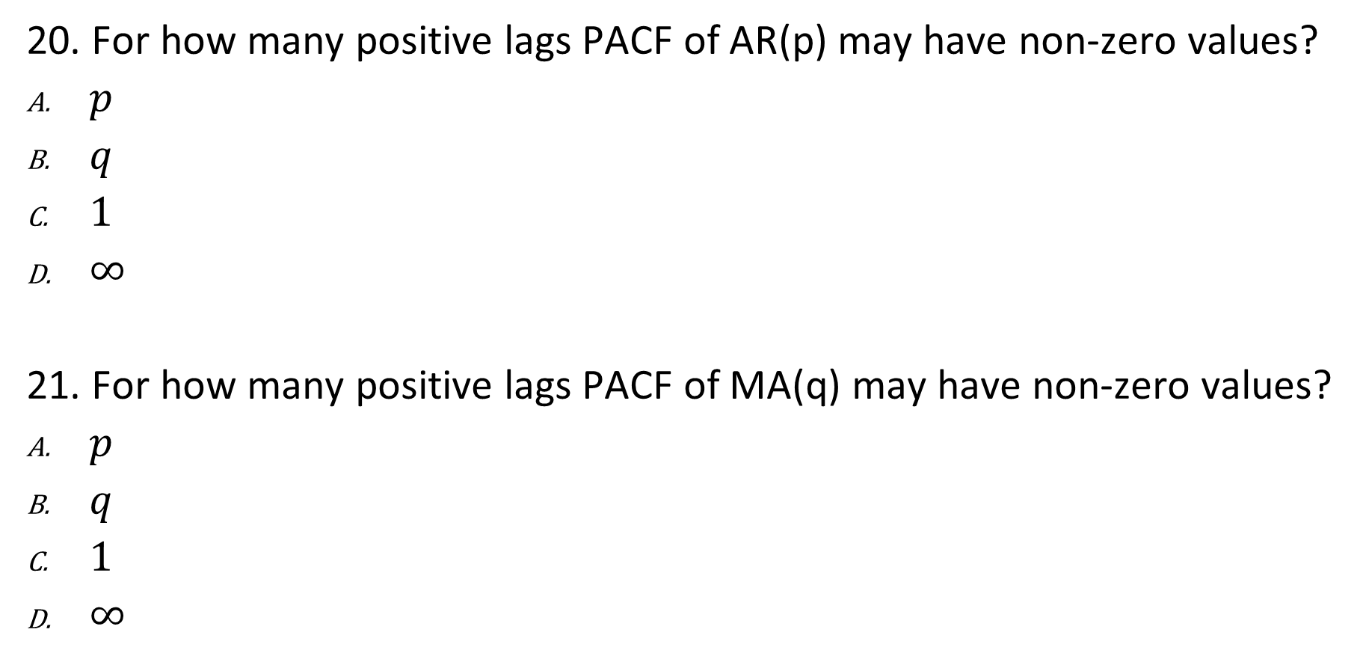
PACF Quiz.
20. For how many positive lags PACF of AR(p) may have non-zero values?
$p$
$q$
$1$
$∞$
21. For how many positive lags PACF of MA(q) may have non-zero values?
$p$
$q$
$1$
$∞$

Slide 38
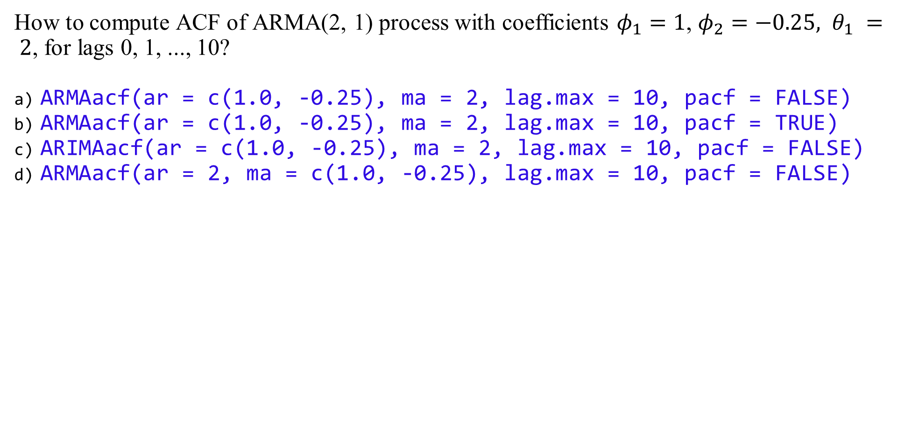
R Quiz. Autocorrelation and Partial Autocorrelation
How to compute ACF of ARMA(2, 1) process with coefficients $φ_{1}=1$, $φ_{2}=−0.25, θ_{1} = 2$, for lags 0, 1, ..., 10?
ARMAacf(ar = c(1.0, -0.25), ma = 2, lag.max = 10, pacf = FALSE)
ARMAacf(ar = c(1.0, -0.25), ma = 2, lag.max = 10, pacf = TRUE)
ARIMAacf(ar = c(1.0, -0.25), ma = 2, lag.max = 10, pacf = FALSE)
ARMAacf(ar = 2, ma = c(1.0, -0.25), lag.max = 10, pacf = FALSE)

Slide 39
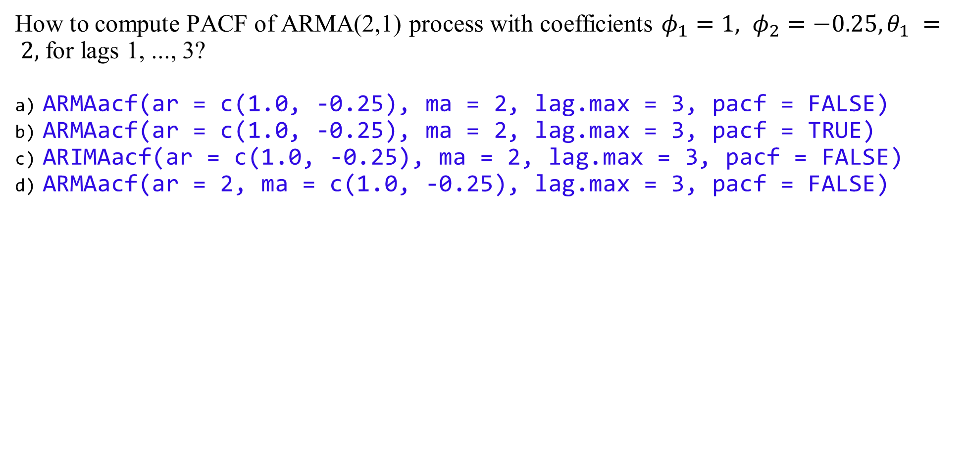
R Quiz. Autocorrelation and Partial Autocorrelation
How to compute PACF of ARMA(2,1) process with coefficients $φ_{1}=1, φ_{2}=−0.25, θ_{1} = 2,$ for lags 1, ..., 3?
ARMAacf(ar = c(1.0, -0.25), ma = 2, lag.max = 3, pacf = FALSE)
ARMAacf(ar = c(1.0, -0.25), ma = 2, lag.max = 3, pacf = TRUE)
ARIMAacf(ar = c(1.0, -0.25), ma = 2, lag.max = 3, pacf = FALSE)
ARMAacf(ar = 2, ma = c(1.0, -0.25), lag.max = 3, pacf = FALSE)

Slide 40
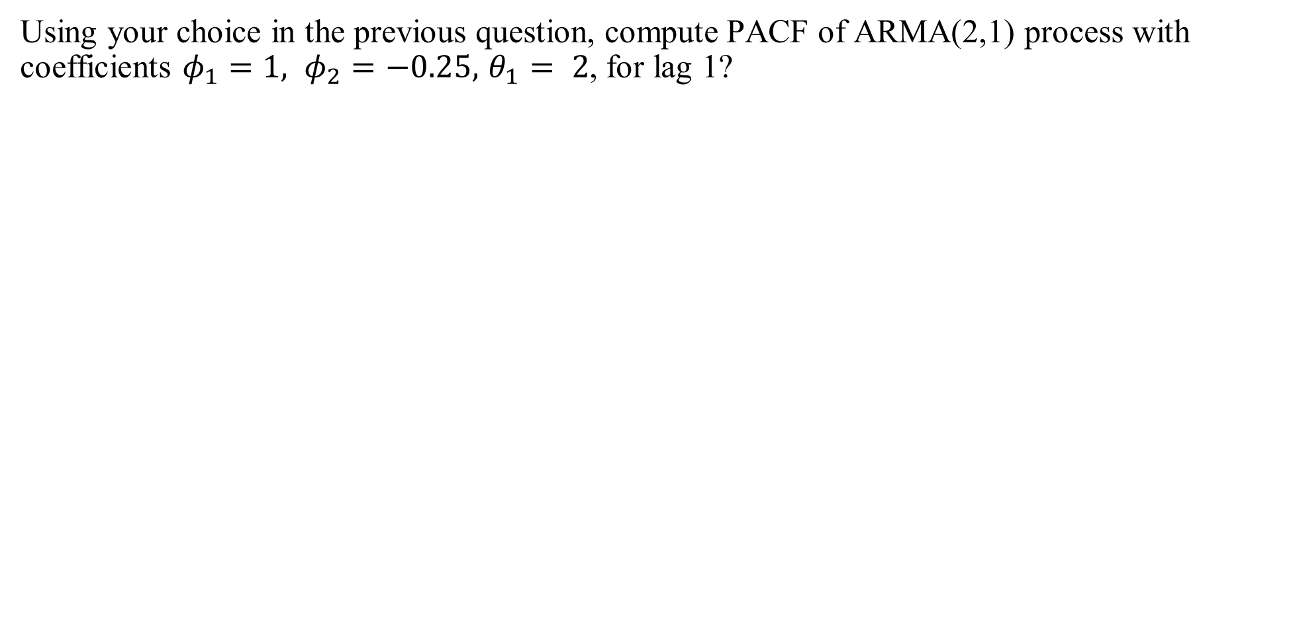
R Quiz. Autocorrelation and Partial Autocorrelation
Using your choice in the previous question, compute PACF of ARMA(2,1) process with coefficients $φ_{1}=1, φ_{2}=−0.25, { θ}_{1} = 2$, for lag 1?

Slide 41
Chapter 3 ARIMA Models
3.4 Forecasting

Slide 42
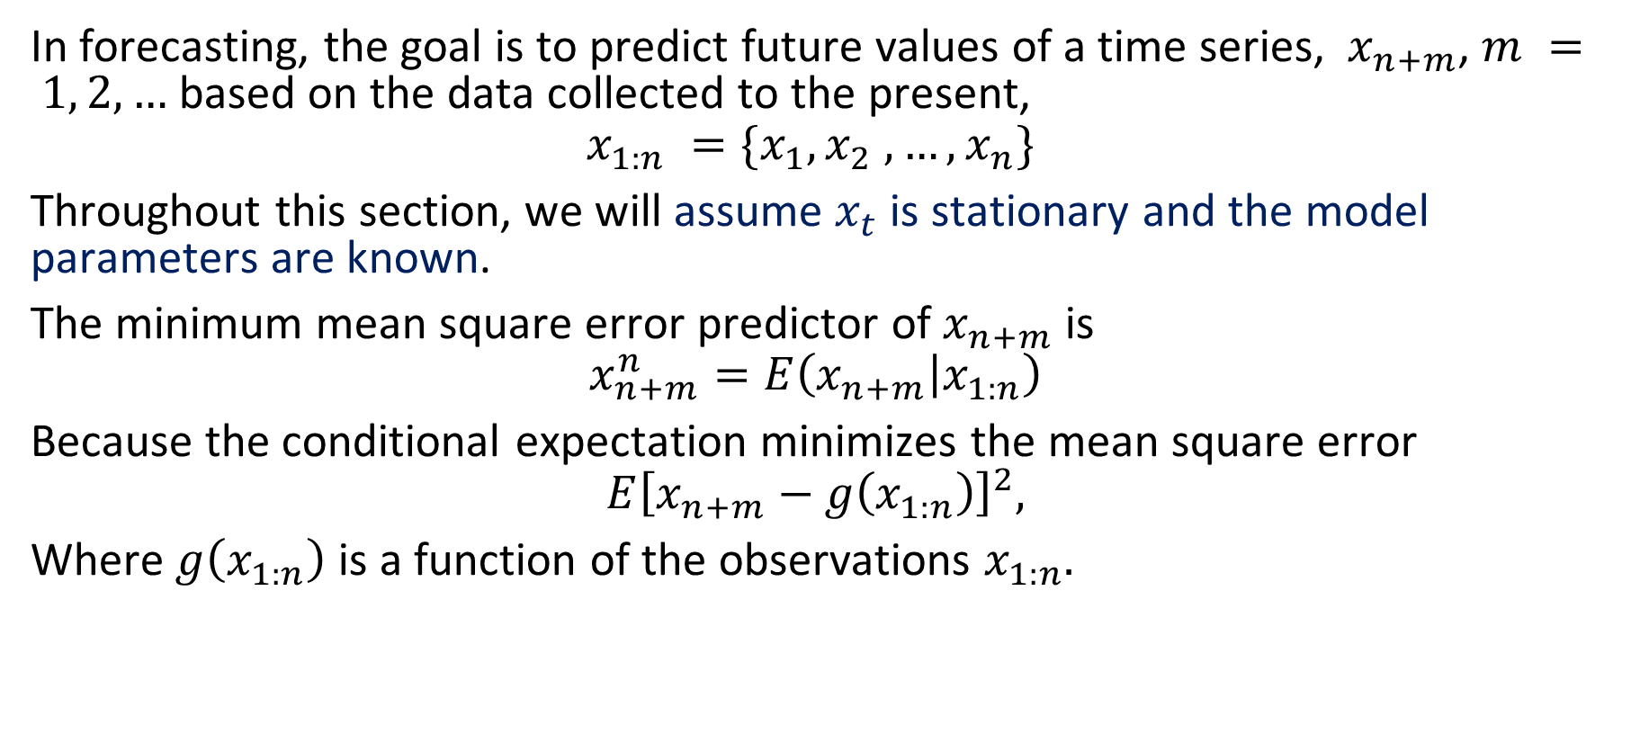
The minimum square error predictor
In forecasting, the goal is to predict future values of a time series, $x_{n+m}$, $m = 1, 2,…$ based on the data collected to the present,
$$x_{1:n} =\{x_{1}, x_{2} ,…, x_{n}\}$$
Throughout this section, we will assume $x_{t}$ is stationary and the model parameters are known.
The minimum mean square error predictor of $x_{n+m}$ is
$$x_{n+m}^{n}=E\left(x_{n+m} | x_{1:n}\right)$$
Because the conditional expectation minimizes the mean square error
$$E{\left[x_{n+m}−g\left(x_{1:n}\right)\right]}^{2},$$
Where $g\left(x_{1:n}\right)$ is a function of the observations $x_{1:n}.$

Slide 43
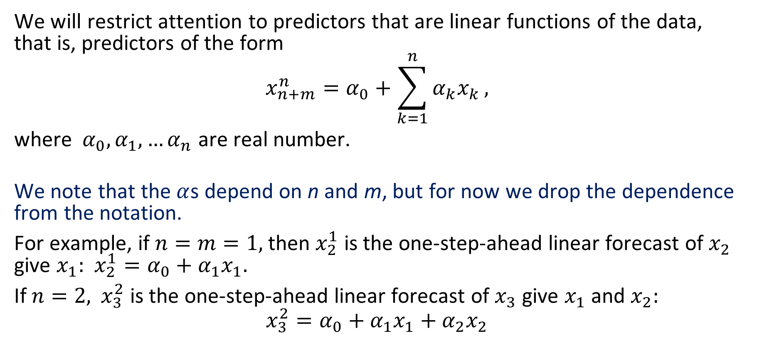
Linear predictors.
We will restrict attention to predictors that are linear functions of the data, that is, predictors of the form
$$x_{n+m}^{n}=α_{0}+\sum_{k=1}^{n}{α_{k}x_{k}},$$
where $α_{0},α_{1},…α_{n}$ are real number.
We note that the $α$s depend on n and m, but for now we drop the dependence from the notation.
For example, if $n=m=1,$ then $x_{2}^{1}$ is the one-step-ahead linear forecast of $x_{2}$ give $x_{1}:$ $x_{2}^{1}=α_{0}+α_{1}x_{1}.$
If $n=2,$ $x_{3}^{2}$ is the one-step-ahead linear forecast of $x_{3}$ give $x_{1}$ and $x_{2}:$
$$x_{3}^{2}=α_{0}+α_{1}x_{1}+α_{2}x_{2}$$

Slide 44
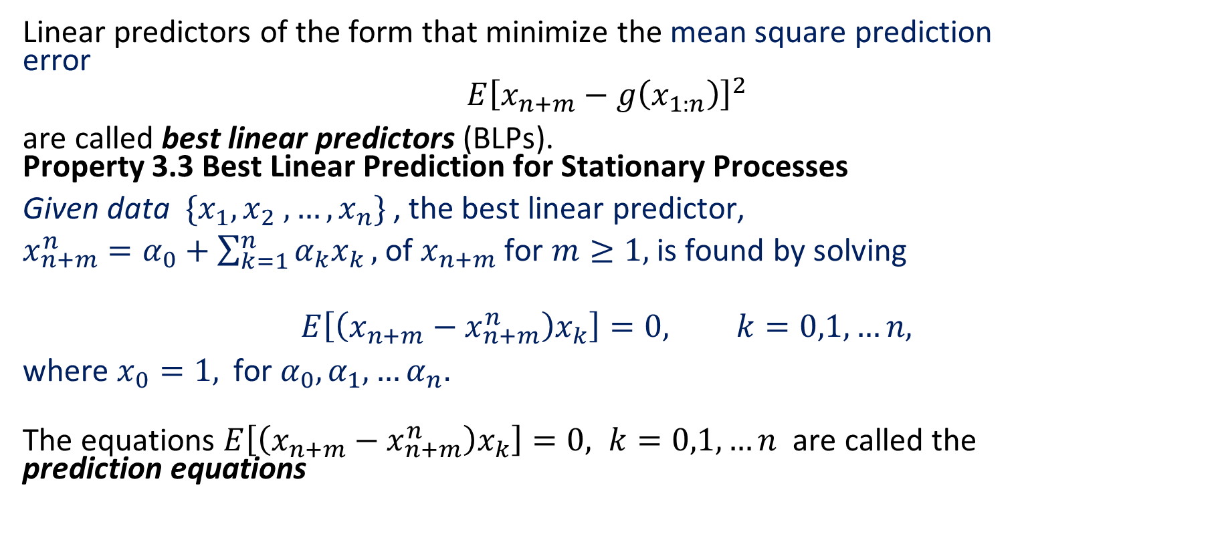
Best linear predictors (BLPs)
Linear predictors of the form that minimize the mean square prediction error
$$E{\left[x_{n+m}−g\left(x_{1:n}\right)\right]}^{2}$$
are called best linear predictors (BLPs). Property 3.3 Best Linear Prediction for Stationary Processes
Given data $\{x_{1}, x_{2} ,…, x_{n}\}$, the best linear predictor,
$x_{n+m}^{n}=α_{0}+\sum_{k=1}^{n}{α_{k}x_{k}},$ of $x_{n+m}$ for $m≥1,$ is found by solving
$$E\left[\left(x_{n+m}−x_{n+m}^{n}\right)x_{k}\right]=0, k=0,1,…n,$$
where $x_{0}=1,$ for $α_{0},α_{1},…α_{n}.$
The equations $E\left[\left(x_{n+m}−x_{n+m}^{n}\right)x_{k}\right]=0, k=0,1,…n$ are called the prediction equations

Slide 45
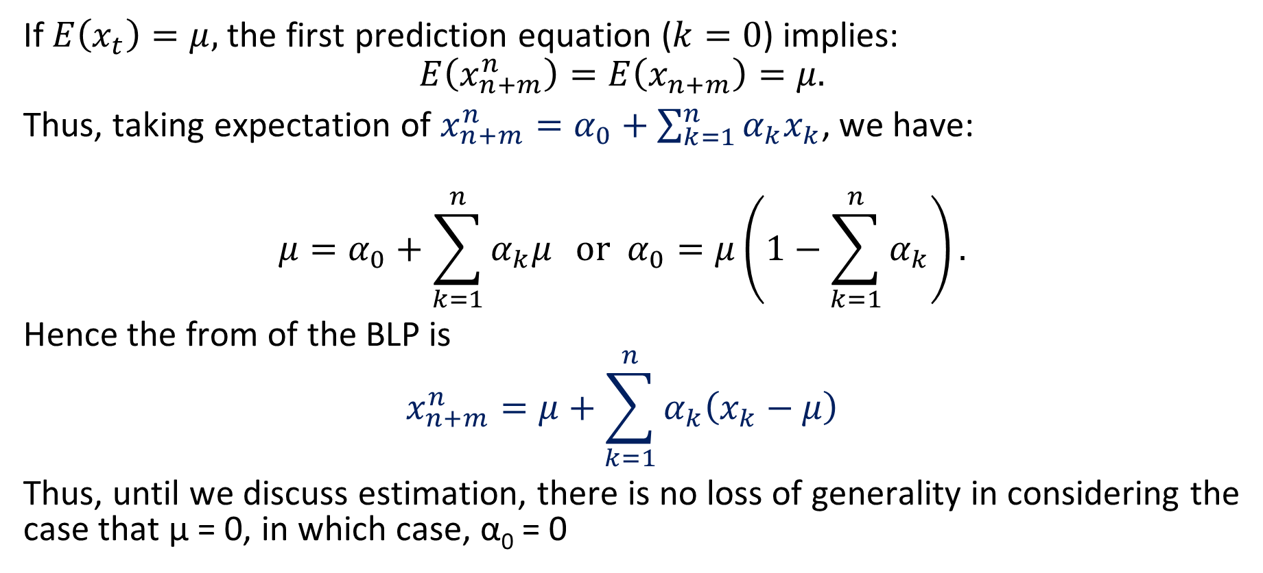
Best linear predictors (BLPs)
If $E\left(x_{t}\right)=μ,$ the first prediction equation ($k=0$) implies:
$$E\left(x_{n+m}^{n}\right)=E\left(x_{n+m}\right)=μ.$$
Thus, taking expectation of $x_{n+m}^{n}=α_{0}+\sum_{k=1}^{n}{α_{k}x_{k}}$, we have:
$$μ=α_{0}+\sum_{k=1}^{n}{α_{k}μ} or α_{0}=μ\left(1−\sum_{k=1}^{n}{α_{k}}\right).$$
Hence the from of the BLP is
$$x_{n+m}^{n}=μ+\sum_{k=1}^{n}{α_{k}\left(x_{k}−μ\right)}$$
Thus, until we discuss estimation, there is no loss of generality in considering the case that µ = 0, in which case, α₀ = 0

Slide 46
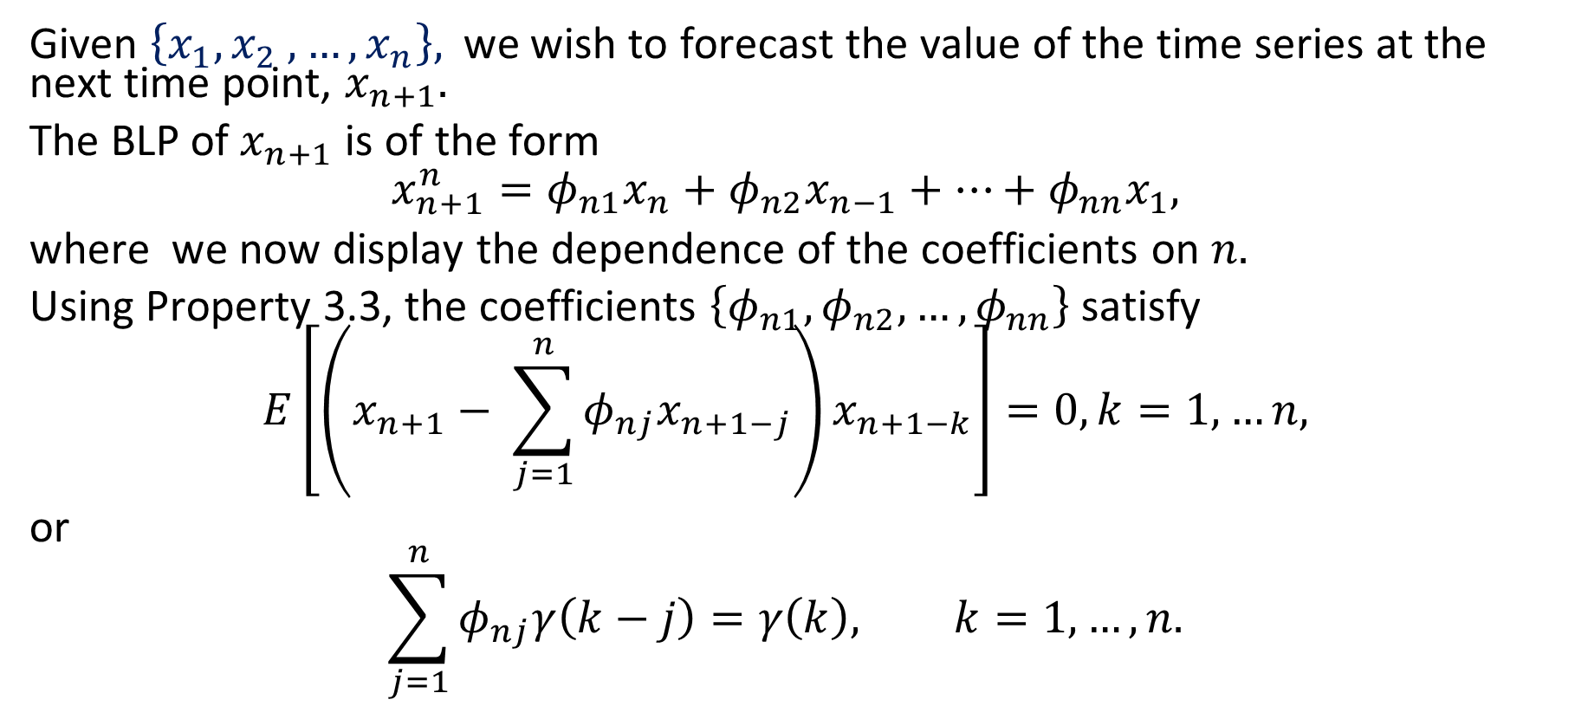
One-step-ahead prediction
Given $\left\{x_{1}, x_{2} ,…, x_{n}\right\},$we wish to forecast the value of the time series at the next time point, $x_{n+1}.$
The BLP of $x_{n+1}$ is of the form
$$x_{n+1}^{n}=φ_{n1}x_{n}+φ_{n2}x_{n−1}+…+φ_{nn}x_{1},$$
where we now display the dependence of the coefficients on $n.$
Using Property 3.3, the coefficients $\left\{φ_{n1},φ_{n2},…, φ_{nn}\right\}$ satisfy
$$E\left[\left(x_{n+1}− \sum_{j=1}^{n}{φ_{nj}x_{n+1−j}}\right)x_{n+1−k}\right]=0, k=1,…n,$$
or
$$\sum_{j=1}^{n}{φ_{nj}γ\left(k−j\right)=γ\left(k\right), k=1,…,n.}$$

Slide 47
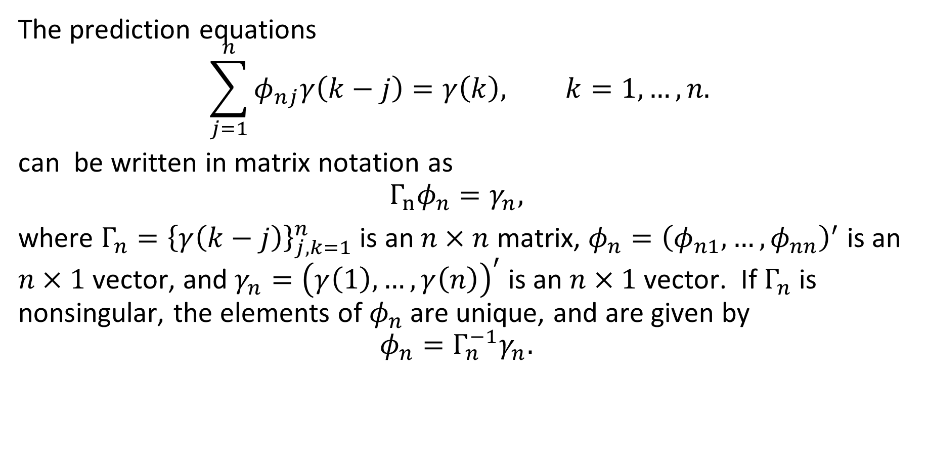
One-step-ahead prediction
The prediction equations
$$\sum_{j=1}^{n}{φ_{nj}γ\left(k−j\right)=γ\left(k\right), k=1,…,n.}$$
can be written in matrix notation as
$$Γ_{n}φ_{n}=γ_{n},$$
where $Γ_{n}={\left\{γ\left(k−j\right)\right\}}_{j,k=1}^{n}$ is an $n×n$ matrix, $φ_{n}={\left(φ_{n1},…, φ_{nn}\right)}^{′}$ is an $n×1$ vector, and $γ_{n}={\left(γ\left(1\right), …, γ\left(n\right)\right)}^{′}$ is an $n×1$ vector. If $Γ_{n}$ is nonsingular, the elements of $φ_{n}$ are unique, and are given by
$$φ_{n}=Γ_{n}^{−1}γ_{n}.$$

Slide 48
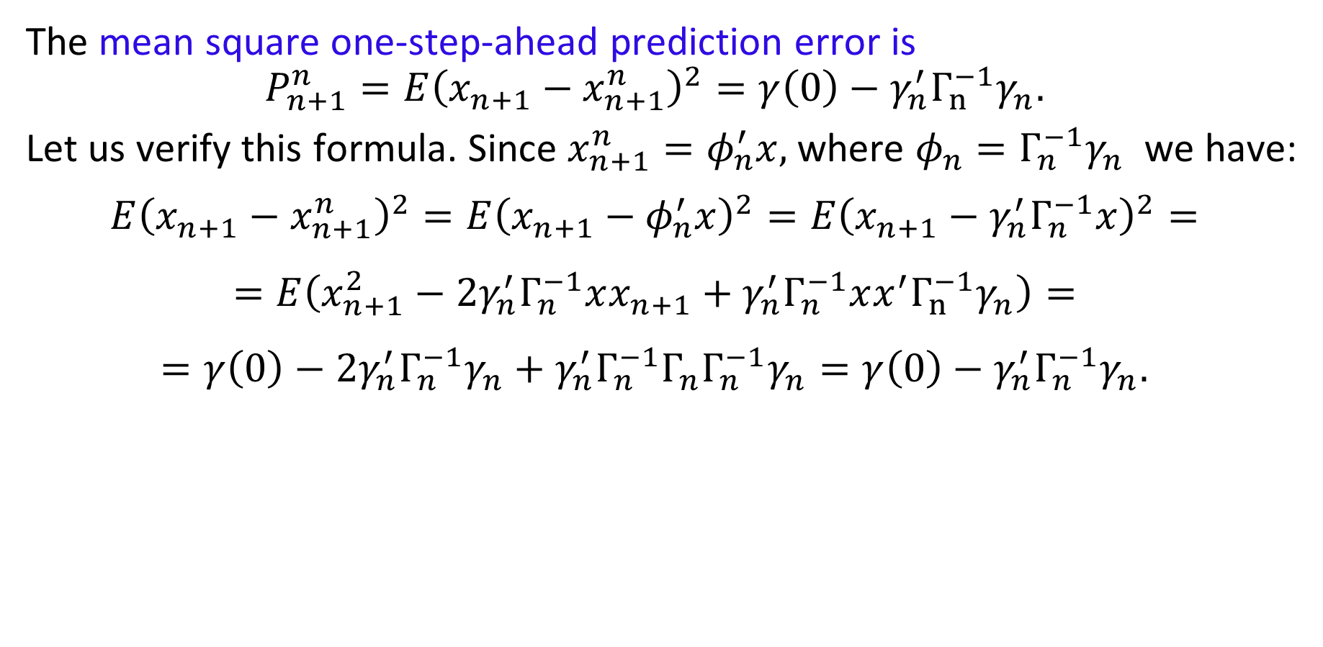
One-step-ahead prediction
The mean square one-step-ahead prediction error is
$$P_{n+1}^{n}=E{\left(x_{n+1}−x_{n+1}^{n}\right)}^{2}=γ\left(0\right)−γ_{n}^{′}Γ_{n}^{−1}γ_{n}.$$
Let us verify this formula. Since $x_{n+1}^{n}=φ_{n}^{′}x,$ where $φ_{n}=Γ_{n}^{−1}γ_{n}$ we have:
$$E{\left(x_{n+1}−x_{n+1}^{n}\right)}^{2}=E{\left(x_{n+1}−φ_{n}^{′}x\right)}^{2}=E{\left(x_{n+1}−γ_{n}^{′}Γ_{n}^{−1}x\right)}^{2}=$$
$$=E\left(x_{n+1}^{2}−2γ_{n}^{′}Γ_{n}^{−1}xx_{n+1}+γ_{n}^{′}Γ_{n}^{−1}xx^{′}Γ_{n}^{−1}γ_{n}\right)=$$
$$=γ\left(0\right)−2γ_{n}^{′}Γ_{n}^{−1}γ_{n}+γ_{n}^{′}Γ_{n}^{−1}Γ_{n}Γ_{n}^{−1}γ_{n}=γ\left(0\right)−γ_{n}^{′}Γ_{n}^{−1}γ_{n}.$$

Slide 49
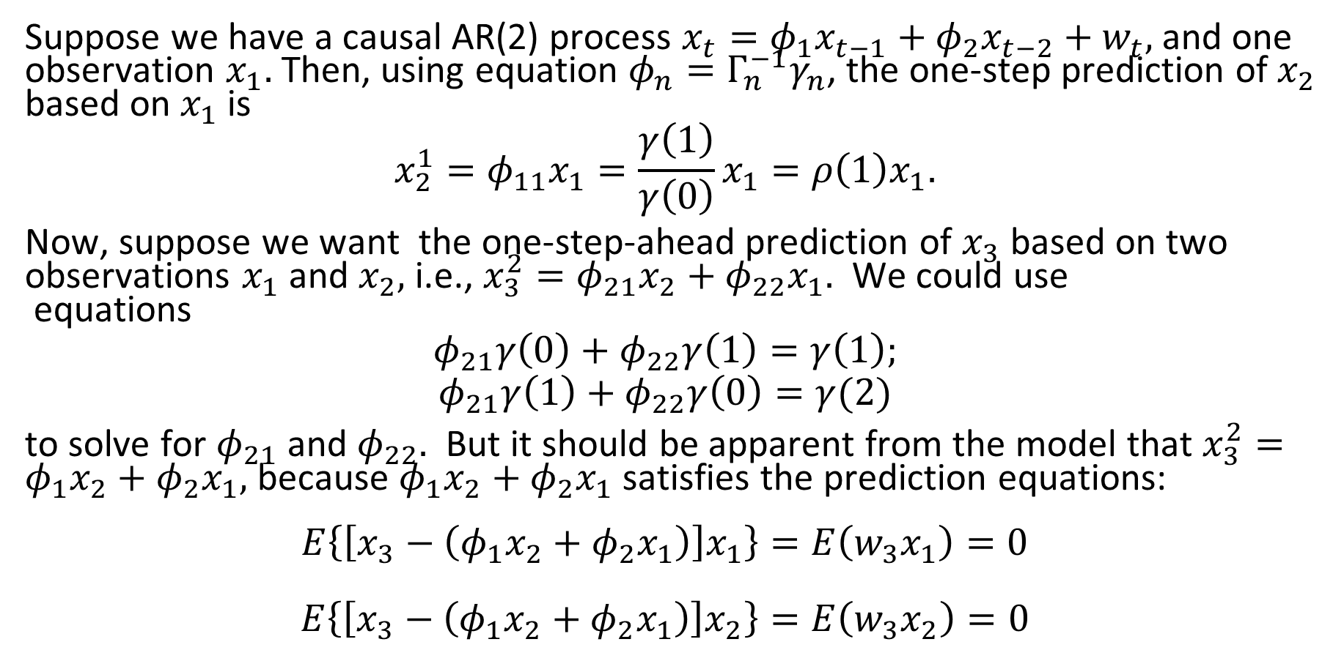
Example 3.19 Prediction for an AR(2)
Suppose we have a causal AR(2) process $x_{t}=φ_{1}x_{t−1}+φ_{2}x_{t−2}+w_{t},$ and one observation $x_{1}.$ Then, using equation $φ_{n}=Γ_{n}^{−1}γ_{n}$, the one-step prediction of $x_{2}$ based on $x_{1}$ is
$$x_{2}^{1}=φ_{11}x_{1}=\frac{γ\left(1\right)}{γ\left(0\right)}x_{1}=ρ\left(1\right)x_{1}.$$
Now, suppose we want the one-step-ahead prediction of $x_{3}$ based on two observations $x_{1}$ and $x_{2},$ i.e., $x_{3}^{2}=φ_{21}x_{2}+φ_{22}x_{1}.$ We could use equations
$$φ_{21}γ\left(0\right)+φ_{22}γ\left(1\right)=γ\left(1\right);$$
$$φ_{21}γ\left(1\right)+φ_{22}γ\left(0\right)=γ(2)$$
to solve for $φ_{21}$ and $φ_{22}.$ But it should be apparent from the model that $x_{3}^{2}=φ_{1}x_{2}+φ_{2}x_{1},$ because $φ_{1}x_{2}+φ_{2}x_{1}$ satisfies the prediction equations:
$$E\left\{\left[x_{3}−\left(φ_{1}x_{2}+φ_{2}x_{1}\right)\right]x_{1}\right\}=E\left(w_{3}x_{1}\right)=0$$
$$E\left\{\left[x_{3}−\left(φ_{1}x_{2}+φ_{2}x_{1}\right)\right]x_{2}\right\}=E\left(w_{3}x_{2}\right)=0$$

Slide 50
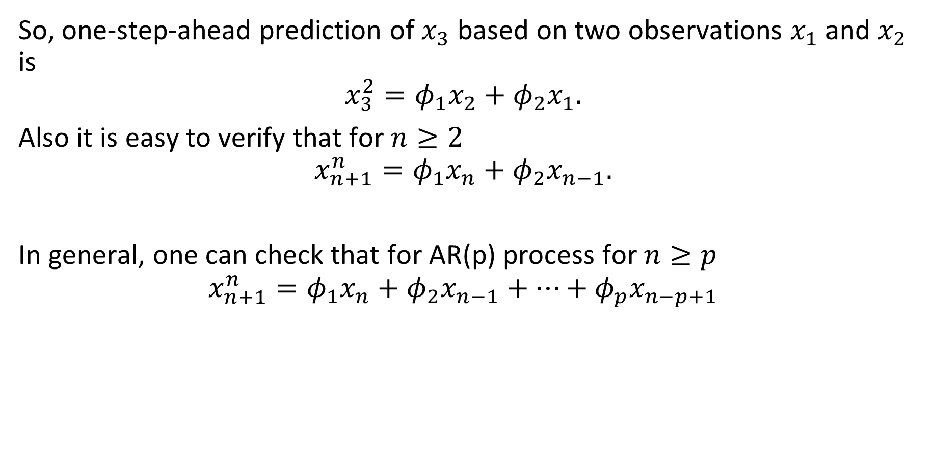
Example 3.19 Prediction for an AR(2) (continued)
So, one-step-ahead prediction of $x_{3}$ based on two observations $x_{1}$ and $x_{2}$ is
$$x_{3}^{2}=φ_{1}x_{2}+φ_{2}x_{1}.$$
Also it is easy to verify that for $n≥2$
$$x_{n+1}^{n}=φ_{1}x_{n}+φ_{2}x_{n−1}.$$
In general, one can check that for AR(p) process for $n≥p$
$$x_{n+1}^{n}=φ_{1}x_{n}+φ_{2}x_{n−1}+…+φ_{p}x_{n−p+1}$$

Slide 51
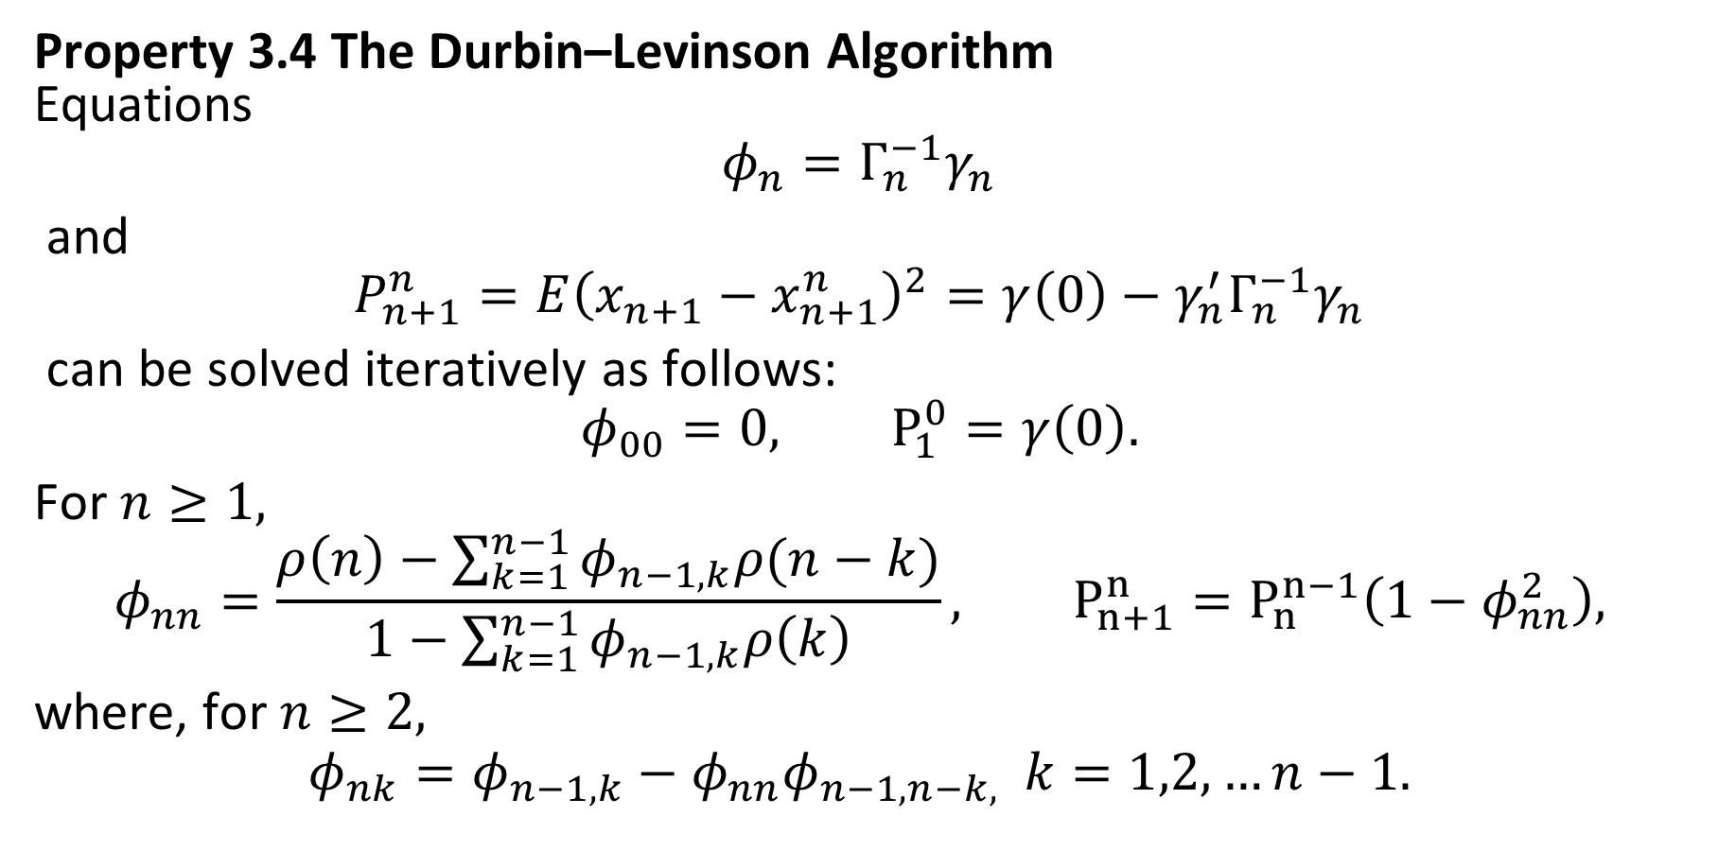
The Durbin–Levinson Algorithm
Property 3.4 The Durbin–Levinson Algorithm Equations
$$φ_{n}=Γ_{n}^{−1}γ_{n}$$
and
$$P_{n+1}^{n}=E{\left(x_{n+1}−x_{n+1}^{n}\right)}^{2}=γ\left(0\right)−γ_{n}^{′}Γ_{n}^{−1}γ_{n}$$
can be solved iteratively as follows:
$$φ_{00}=0, P_{1}^{0}=γ\left(0\right).$$
For $n≥1,$
$$φ_{nn}=\frac{ρ\left(n\right)−\sum_{k=1}^{n−1}{φ_{n−1,k}ρ(n−k)}}{1−\sum_{k=1}^{n−1}{φ_{n−1,k}ρ\left(k\right)}}, P_{n+1}^{n}=P_{n}^{n−1}\left(1−φ_{nn}^{2}\right),$$
where, for $n≥2,$
$$φ_{nk}=φ_{n−1,k}−φ_{nn}φ_{n−1,n−k,} k=1,2,…n−1.$$

Slide 52
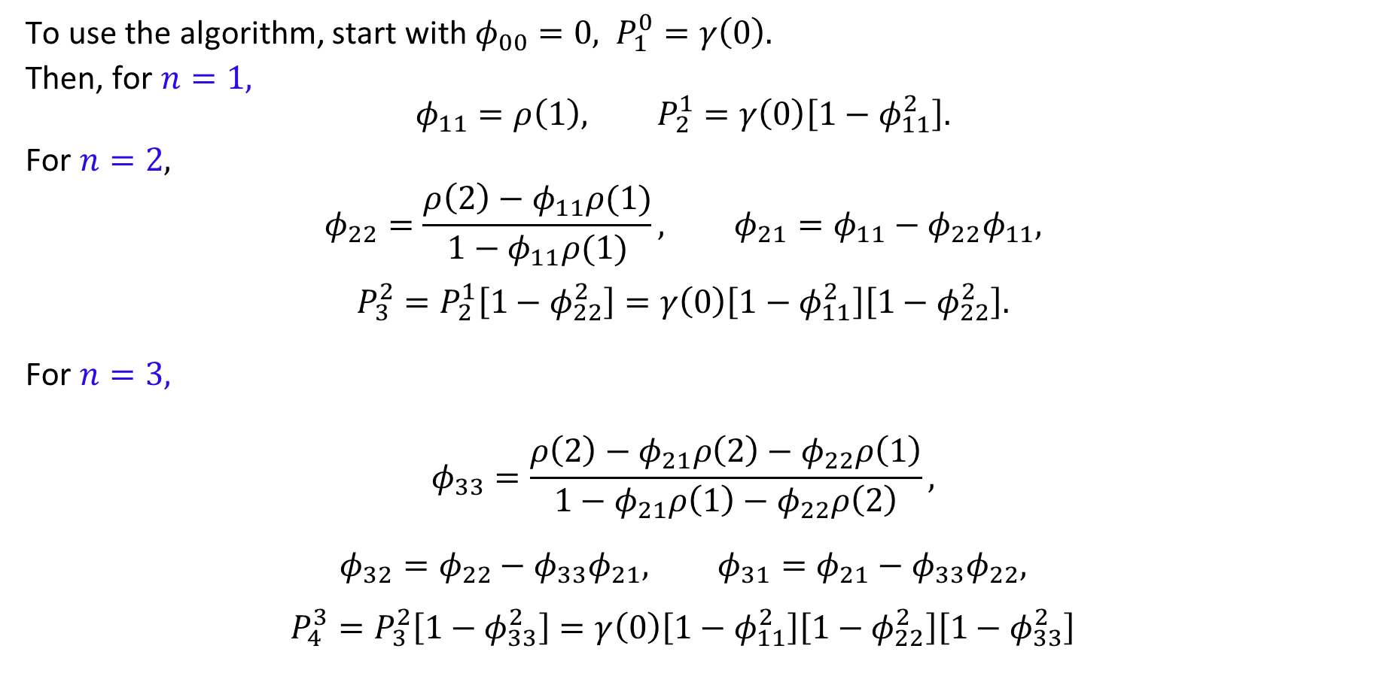
Example 3.20 Using the Durbin–Levinson Algorithm
To use the algorithm, start with $φ_{00}=0,$ $P_{1}^{0}=γ\left(0\right).$
Then, for $n=1,$
$$φ_{11}=ρ\left(1\right), P_{2}^{1}=γ\left(0\right)\left[1−φ_{11}^{2}\right].$$
For $n=2,$
$$φ_{22}=\frac{ρ\left(2\right)−φ_{11}ρ(1)}{1−φ_{11}ρ(1)}, φ_{21}=φ_{11}−φ_{22}φ_{11},$$
$$P_{3}^{2}=P_{2}^{1}\left[1−φ_{22}^{2}\right]=γ\left(0\right)\left[1−φ_{11}^{2}\right]\left[1−φ_{22}^{2}\right].$$
For $n=3,$
$$φ_{33}=\frac{ρ\left(2\right)−φ_{21}ρ\left(2\right)−φ_{22}ρ\left(1\right)}{1−φ_{21}ρ\left(1\right)−φ_{22}ρ\left(2\right)},$$
$$φ_{32}=φ_{22}−φ_{33}φ_{21}, φ_{31}=φ_{21}−φ_{33}φ_{22},$$
$$P_{4}^{3}=P_{3}^{2}\left[1−φ_{33}^{2}\right]=γ\left(0\right)\left[1−φ_{11}^{2}\right]\left[1−φ_{22}^{2}\right]\left[1−φ_{33}^{2}\right]$$

Slide 53
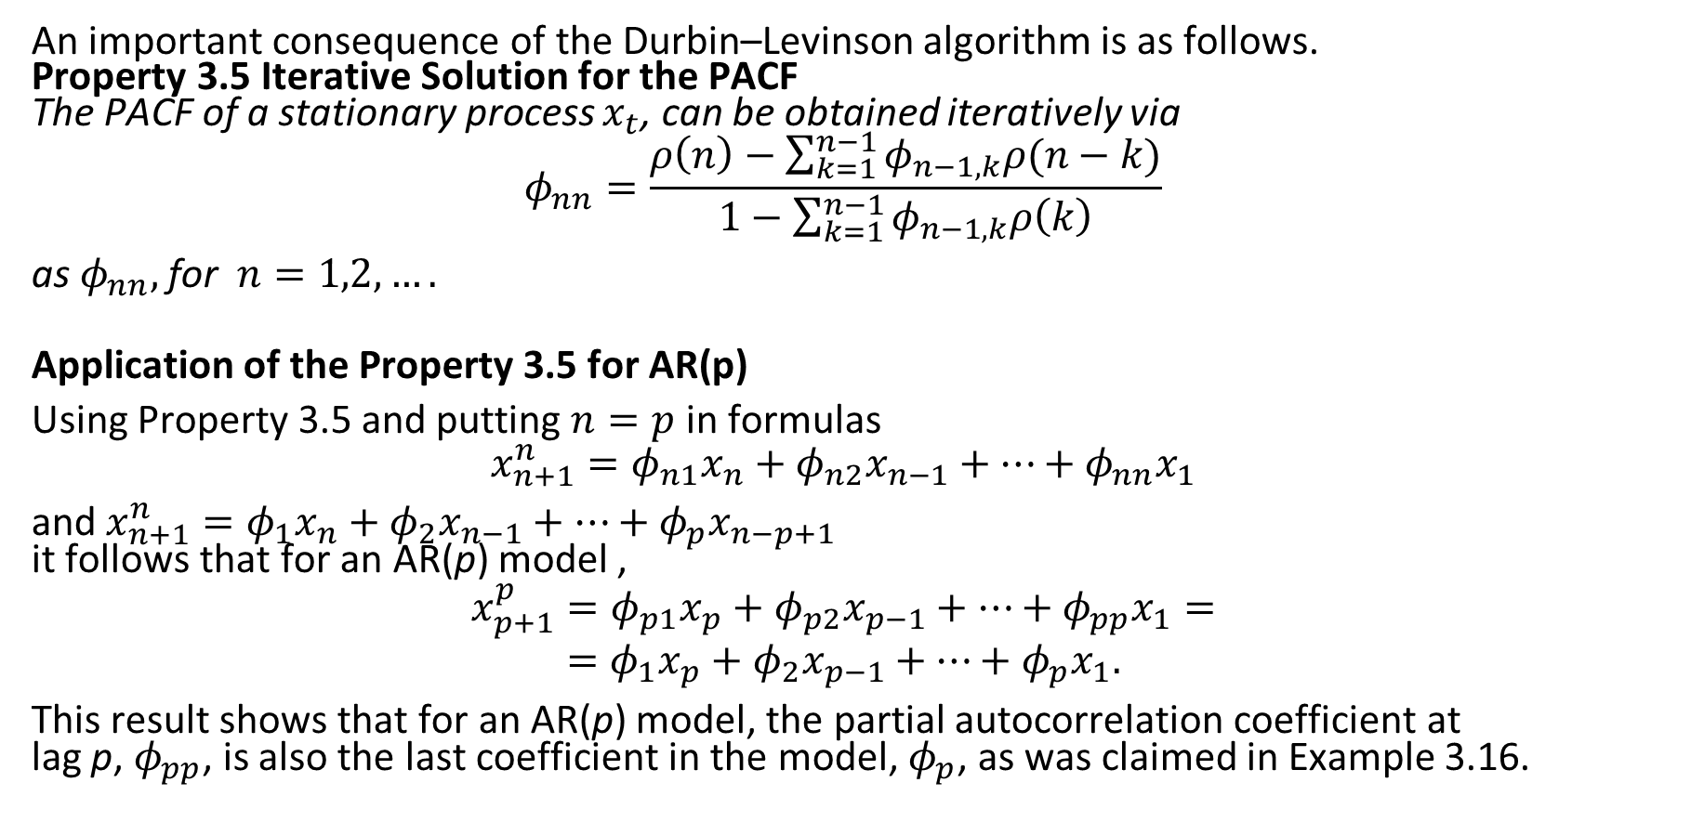
Iterative Solution for the PACF
An important consequence of the Durbin–Levinson algorithm is as follows. Property 3.5 Iterative Solution for the PACF The PACF of a stationary process $x_{t}$, can be obtained iteratively via
$$φ_{nn}=\frac{ρ\left(n\right)−\sum_{k=1}^{n−1}{φ_{n−1,k}ρ(n−k)}}{1−\sum_{k=1}^{n−1}{φ_{n−1,k}ρ\left(k\right)}}$$
as $φ_{nn},$for $n=1,2,….$
Application of the Property 3.5 for AR(p)
Using Property 3.5 and putting $n=p$ in formulas
$$x_{n+1}^{n}=φ_{n1}x_{n}+φ_{n2}x_{n−1}+…+φ_{nn}x_{1}$$
and $x_{n+1}^{n}=φ_{1}x_{n}+φ_{2}x_{n−1}+…+φ_{p}x_{n−p+1}$ it follows that for an AR(p) model ,
$$x_{p+1}^{p}=φ_{p1}x_{p}+φ_{p2}x_{p−1}+…+φ_{pp}x_{1}=$$
$$=φ_{1}x_{p}+φ_{2}x_{p−1}+…+φ_{p}x_{1}.$$
This result shows that for an AR(p) model, the partial autocorrelation coefficient at lag p, $φ_{pp}$, is also the last coefficient in the model, $φ_{p}$, as was claimed in Example 3.16.

Slide 54

Example 3.21 The PACF of an AR(2)
We use Example 3.10 (The ACF of an AR(2) Process) and Property 3.5(Iterative Solution for the PACF) to calculate first three values $φ_{11},φ_{22}, φ_{33}$ of the PACF.
Recall from example 3.10 that we have:
$$ρ\left(1\right)=\frac{φ_{1}}{1−φ_{2}}, ρ\left(2\right)=φ_{1}ρ\left(1\right)+φ_{2}, ρ\left(3\right)−φ_{1}ρ\left(2\right)−φ_{2}ρ\left(1\right)=0.$$
Thus,
$$φ_{11}=ρ\left(1\right)=\frac{φ_{1}}{1−φ_{2}}$$
$$φ_{22}=\frac{ρ\left(2\right)−ρ{\left(1\right)}^{2}}{1−ρ{\left(1\right)}^{2}}=\frac{\left[φ_{1}\left(φ_{1}/(1−φ_{2})\right)+φ_{2}\right]−{\left(φ_{1}/(1−φ_{2})\right)}^{2}}{1−(φ_{1}/{\left(1−φ_{2})\right)}^{2}}=φ_{2}$$
$$φ_{21}=ρ\left(1\right)\left[1−φ_{2}\right]=φ_{1}$$
$$φ_{33}=\frac{ρ\left(3\right)−φ_{1}ρ\left(2\right)−φ_{2}ρ\left(1\right)}{1−φ_{1}ρ\left(1\right)−φ_{2}ρ\left(2\right)}=0.$$

Slide 55
M-step-ahead predictor
Property 3.3 allows us to calculate the BLP of $x_{n+m}$ for any $m≥1.$
Given data, $\left\{x_{1},…x_{n}\right\}$, the m-step-ahead predictor is
$$x_{n+m}^{n}=φ_{n1}^{(m)}x_{n}+φ_{n2}^{\left(m\right)}x_{n−1}+…+φ_{nn}^{\left(m\right)}x_{1},$$
where $\{φ_{n1}^{\left(m\right)}, φ_{n2}^{\left(m\right)},…, φ_{nn}^{\left(m\right)}\}$ satisfy the prediction equations,
$$\sum_{j=1}^{n}{φ_{nj}^{\left(m\right)}E\left(x_{n+1−j}x_{n+1−k}\right)}=E\left(x_{n+m}, x_{n+1−k}\right), k=1,…, n.$$
or
$$\sum_{j=1}^{n}{φ_{nj}^{\left(m\right)}γ\left(k−j\right)}=γ\left(m+k−1\right), k=1,…, n.$$

Slide 56
M-step-ahead predictor
The prediction equations can again be written in matrix notation as
$$Γ_{n}φ_{n}^{\left(m\right)}=γ_{n}^{\left(m\right)},$$
where $γ_{n}^{\left(m\right)}={\left(γ\left(m\right),…, γ\left(m+n−1\right)\right)}^{′},$ and $φ_{n}^{\left(m\right)}={\left(φ_{n1}^{\left(m\right)}, …, φ_{nn}^{\left(m\right)} \right)}^{′}$ are $n×1$ vectors.
The mean square m-step-ahead prediction error is
$$P_{n+m}^{n}=E{\left(x_{n+m}−x_{n+m}^{n}\right)}^{2}=γ\left(0\right)−γ_{n}^{\left(m\right)}Γ_{n}^{−1}γ_{n}^{\left(m\right)}$$

Slide 57
Property 3.6 The Innovations Algorithm
The one-step-ahead predictors$, x_{t+1}^{t}$, and their mean-squared errors, $P_{t+1}^{t}$, can be calculated iteratively as
$$x_{1}^{0}=0, P_{1}^{0}=γ(0)$$
$$x_{t+1}^{t}= \sum_{j=1}^{t}{θ_{tj}\left(x_{t+1−j}−x_{t+1−j}^{t−j}\right)}, t=1,2,…$$
$$P_{t+1}^{t}=γ\left(0\right)−\sum_{j=0}^{t−1}{θ_{t,t−j}^{2}P_{j+1}^{j}}, t=1,2,…$$
where, for $j=0,1,…t−1,$
$$θ_{t,t−j}=\frac{\left(γ\left(t−j\right)−\sum_{k=0}^{j−1}{θ_{j,j−k}θ_{t,t−k}P_{k+1}^{k}}\right)}{P_{j+1}^{j}}$$

Slide 58
Example 3.22 Prediction for an MA(1)
The innovations algorithm lends itself well to prediction for moving average processes. Consider an MA(1) model, $x_{t}=w_{t}+θw_{t−1}.$
Recall that $γ\left(0\right)=\left(1+θ^{2}\right)σ_{w}^{2}, γ\left(1\right)=θσ_{w}^{2}$ and $γ\left(h\right)=0$ for $h>1.$
Then, using Property 3.6 we have:
$$θ_{n1}=\frac{θσ_{w}^{2}}{P_{n}^{n−1}}$$
$$θ_{nj}=0, j=2,…,n.$$
$$P_{1}^{0}=\left(1+θ^{2}\right)σ_{w}^{2}$$
$$P_{n+1}^{n}=\left(1+θ^{2}−θθ_{n1}\right)σ_{w}^{2}.$$ Finally, the one-step-ahead predictor is
$$x_{n+1}^{n}=\frac{θ\left(x_{n}−x_{n}^{n−1}\right)σ_{w}^{2}}{P_{n}^{n−1}}.$$

Slide 59
Forecasting ARMA Processes
Throughout, we assume $x_{t}$ is a causal and invertible ARMA(p; q) process, $$φ\left(B\right)x_{t}=θ\left(B\right)w_{t},$$
where $w_{t}∼iid N\left(0,σ_{w}^{2}\right).$
Consider two types of forecasts:
1. $x_{n+m}^{n}$ is the minimum mean square error predictor of $x_{n+m}$ based on the data $\left\{x_{n},…, x_{1}\right\},$ that is,
$$x_{n+m}^{n}=E\left(x_{n+m} | x_{n}, …, x_{1}\right).$$
2. ${\tilde{x}}_{n+m}$ is the minimum mean square error predictor of $x_{n+m}$ based on the data $\left\{x_{n},…, x_{1}, x_{0},x_{−1},…\right\},$ that is,
$$x_{n+m}^{n}=E\left(x_{n+m} | x_{n}, …, x_{1},x_{0},x_{−1},…\right).$$

Slide 60

Forecasting ARMA Processes
Write $x_{n+m}$ in its causal form:
$$x_{n+m}= \sum_{j=0}^{∞}{ψ_{j}w_{n+m−j}}, ψ_{0}=1$$
Taking conditional expectation, we have
$${\tilde{x}}_{n+m}= \sum_{j=0}^{∞}{ψ_{j}{\tilde{w}}_{n+m−j}}=\sum_{j=0}^{∞}{ψ_{j}w_{n+m−j}},$$
because, by causality and invertibility,
$${\tilde{w}}_{t}=E\left(w_{t} | x_{n}, x_{n−1}, …, x_{0},x_{−1},…\right)=\left\{\begin{aligned}0 t>n, \\ w_{t} t≤n. \end{aligned}\right.$$

Slide 61

Forecasting ARMA Processes
Write $x_{n+m}$ in its invertible forms: $$w_{n+m}= \sum_{j=0}^{∞}{π_{j}x_{n+m−j}}, π_{0}=1$$
Taking conditional expectation in the first representation:
$${0=\tilde{x}}_{n+m}+ \sum_{j=1}^{∞}{π_{j}{\tilde{x}}_{n+m−j}},$$
or,
$${\tilde{x}}_{n+m}=−\sum_{j=1}^{m−1}{π_{j}{\tilde{x}}_{n+m−j}}−\sum_{j=m}^{∞}{π_{j}x_{n+m−j}},$$
using the fact $E\left(x_{t} | x_{n}, x_{n−1}, …x_{0},x_{−1},…\right)=x_{t}$ for $t≤n.$
Prediction is accomplished recursively using obtained formula, starting with the one-step-ahead predictor, m = 1,and then continuing for m = 2,3,….

Slide 62

Forecasting ARMA Processes
Using formula ${\tilde{x}}_{n+m}= \sum_{j=0}^{∞}{ψ_{j}{\tilde{w}}_{n+m−j}}=\sum_{j=0}^{∞}{ψ_{j}w_{n+m−j}}$
$$x_{n+m}−{\tilde{x}}_{n+m}=\sum_{j=0}^{m−1}{ψ_{j}w_{n+m−j},}$$
so the mean-square predictions error can be written as
$$P_{n+m}^{n}=E{\left(x_{n+m}−{\tilde{x}}_{n+m}\right)}^{2}=σ_{w}^{2}\sum_{j=0}^{m−1}{ψ_{j}^{2}.}$$
Also, we note, for a fixed sample size, n, the prediction errors are correlated. That is, for k ≥ 1, $$E\left\{\left(x_{n+m}−{\tilde{x}}_{n+m} \right)\left(x_{n+m+k}−{\tilde{x}}_{n+m+k}\right)\right\}=σ_{w}^{2}\sum_{j=0 }^{m−1}{ψ_{j}ψ_{j+k}.}$$

Slide 63

Example 3.23 Long-Range Forecasts
Consider forecasting an ARMA process with mean${ μ}_{x}$ taking conditional expectation in
$$x_{n+m}−μ_{x}= \sum_{j=0}^{∞}{ψ_{j}w_{n+m−j}}, ψ_{0}=1$$
we deduce that the m-step-ahead forecast can be written as
$${\tilde{x}}_{n+m}=μ_{x}+\sum_{j=m }^{∞}{ψ_{j}w_{n+m−j}.}$$ Noting that the $ψ$-weights dampen to zero exponentially fast, it is clear that
$${\tilde{x}}_{n+m}→μ_{x}$$
exponentially fast (in the mean square sense) as $m→∞$. Moreover, the mean square prediction error
$$P_{n+m}^{n}→σ_{w}^{2}\sum_{j=0}^{∞}{ψ_{j}^{2}}=γ_{x}\left(0\right)=σ_{x}^{2}$$
exponentially fast as $m→∞$.

Slide 64

Truncated predictor
When n is large, we would use the formula
$${\tilde{x}}_{n+m}=−\sum_{j=1}^{m−1}{π_{j}{\tilde{x}}_{n+m−j}}−\sum_{j=m}^{∞}{π_{j}x_{n+m−j}},$$
by truncating, because we do not observe $\{x_{0},x_{−1}, x_{−2}, …\}$ and only the data $\{x_{1}, x_{2},…, x_{n}\}$ are available. The truncated predictor is then written as $${\tilde{x}}_{n+m}=−\sum_{j=1}^{m−1}{π_{j}{\tilde{x}}_{n+m−j}}−\sum_{j=m}^{n+m−1}{π_{j}x_{n+m−j}},$$

Slide 65

Property 3.7 Truncated Prediction for ARMA
For ARMA(p,q) models, the truncated predictors for $m=1,2,…,$ are
$${\tilde{x}}_{n+m}^{n}=φ_{1}{\tilde{x}}_{n+m−1}^{n}+ …+φ_{p}{\tilde{x}}_{n+m −p}^{n}+θ_{1}{\tilde{w}}_{n+m−1}^{n}+ …+θ_{q}{\tilde{w}}_{n+m−q}^{n},$$
where ${\tilde{x}}_{t}^{n}=x_{t}$ for $1≤t≤n$ and ${\tilde{x}}_{t}^{n}=0$ for $t≤0.$
The truncated prediction errors are given by:
$${\tilde{w}}_{t}^{n}=0 for t≤0 or t>n$$
$${\tilde{w}}_{t}^{n}=φ\left(B\right){\tilde{x}}_{t}^{n}−θ_{1}{\tilde{w}}_{t−1}^{n}−…−θ_{q}{\tilde{w}}_{t−q}^{n} for 1≤t≤n.$$

Slide 66

Example 3.24 Forecasting an ARMA(1,1) Series
Given data $x_{1},…, x_{n},$ for forecasting purposes, write the model as
$$x_{n+1}=φx_{n}+w_{n+1}+θw_{n}.$$
Then, based on the formula for the truncated predictors from Property 3.7,
the one-step-ahead truncated forecast is
$${\tilde{x}}_{n+1}^{n}=φx_{n}+0+θ{\tilde{w}}_{n}^{n}.$$
For $m≥2,$ we have
$${\tilde{x}}_{n+m}^{n}=φ{\tilde{x}}_{n+m−1}^{n},$$
which can be calculated recursively, $m=2,3,…$
To calculate ${\tilde{w}}_{n}^{n},$ the model can be written as $w_{t}=x_{t}−φx_{t−1}−θw_{t−1}$ for $t=1,…, n.$ For truncated forecasting, put ${\tilde{w}}_{0}^{n}=0, x_{0}=0,$ and then iterate the errors forward in time
$${\tilde{w}}_{t}^{n}=x_{t}−φx_{t−1}−θ{\tilde{w}}_{t−1}^{n}, t=1,…, n.$$

Slide 67

Prediction intervals
To assess the precision of the forecasts, prediction intervals are typically calculated along with the forecasts. In general, (1 – α) prediction intervals are of the form $$x_{n+m}^{n}±c_{\frac{α}{2}}\sqrt{P_{n+m}^{n}},$$
where $c_{α/2}$ is chosen to get the desired degree of confidence.
For example, if the process is Gaussian, then choosing $c_{\frac{α}{2}} = 2$will yield an approximate 95% prediction interval for $x_{n+m}.$

Slide 68


Example 3.25 Forecasting the Recruitment Series
Using the parameter estimates as the actual parameter values, Figure shows the result of forecasting the Recruitment series given in Example 3.18 over a 24-month horizon, m = 1,2,…24.
The actual forecasts are calculated as $$x_{n+m}^{n}=6.74+1.35x_{n+m−1}^{n}−0.46 x_{n+m−2}^{n}$$
regr = ar.ols(rec, order=2, demean=FALSE, intercept=TRUE) fore = predict(regr, n.ahead=24) ts.plot(rec, fore$pred, col=1:2, xlim=c(1980,1990),
ylab="Recruitment") U = fore$pred+fore$se; L = fore$pred-fore$se xx = c(time(U), rev(time(U))); yy = c(L, rev(U)) polygon(xx, yy, border = 8, col = gray(.6, alpha = .2)) lines(fore$pred, type="p", col=2)

Slide 69

Example 3.25 continued
The forecasts errors $P_{n+m}^{n}$ are calculated using the formula
$$P_{n+m}^{n}=σ_{w}^{2}\sum_{j=0}^{m−1}{ψ_{j}^{2}.}$$
Recall that ${\hat{σ}}_{w}^{2}=89.72$ we have $ψ_{j}=1.35 ψ_{j−1}−0.46 ψ_{j−2}$ for $j≥2,$ where $φ_{0}=1$ and $ψ_{1}=1.35.$ Thus, for n=453,
$$P_{n+1}^{n}=89.72,$$
$$P_{n+2}^{n}=89.72\left(1+{1.35}^{2}\right),$$
$$P_{n+3}^{n}=89.72\left(1+{1.35}^{2}+{\left[{1.35}^{2}−0.46\right]}^{2}\right) ,$$
and so on.

Slide 70

Backcasting
In backcasting, we want to predict $x_{1−m}$, for $m=1,2,…,$based on the data $\left\{x_{1},…x_{n}\right\}$.
Write the backcast as $$x_{1−m}^{n}= \sum_{j=1}^{n}{α_{j}x_{j}}.$$
The prediction equations (assuming $μ_{x}=0)$are
$$\sum_{j=1}^{n}{α_{j}E\left(x_{j}x_{k}\right)}=E\left(x_{1−m}x_{k}\right), k=1,…n,$$
or
$$\sum_{j=1}^{n}{α_{j}γ(k−j)}=γ(m+k−1), k=1,…n,$$
These equations are precisely the prediction equations for forward prediction. That is, $α_{j}=φ_{nj}^{\left(m\right)},$ for $j=1,…n.$ Finally, the backcasts are given by
$$x_{1−m}^{m}=φ_{n1}^{\left(m\right)}x_{1}+…+φ_{nn}^{\left(m\right)}x_{n}, m=1,2,…$$

Slide 71

Example 3.26 Backcasting an ARMA(1,1)
Consider an ARMA(1,1) process, $x_{t}=φx_{t−1}+θw_{t−1}+w_{t};$ we will call this the forward model. We have just seen that best linear prediction backward in time is the same as best linear prediction forward in time for stationary models. Assuming the models are Gaussian, we also have that minimum mean square error prediction backward in time is the same as forward in time for ARMA models. Thus, the process can equivalently be generated by the backward model,
$$x_{t}=φx_{t+1}+θν_{t+1}+ν_{t},$$
where $\{ν_{t}\}$ is a Gaussian white noise process with variance $σ_{w}^{2}.$ We may write $x_{t}= \sum_{j=0}^{∞}{ψ_{j}ν_{t+j}}$, where $ψ_{0}=1.$

Slide 72

Example 3.26 Backcasting an ARMA(1,1)
Given data $\left\{x_{1},…, x_{n}\right\},$ truncate $ν_{n}^{n}=E(ν_{n}|x_{1},…, x_{n})$ to zero and then iterate backward. That is, put ${\tilde{ν}}_{n}^{n}=0,$ as an initial approximation, and then generate the errors backward
$${\tilde{ν}}_{t}^{n}=x_{t}−φx_{t+1}−θ{\tilde{ν}}_{t+1}^{n}, t=\left(n−1\right), \left(n−2\right), …1.$$
Then,
$${\tilde{x}}_{0}^{n}=φx_{1}+θ{\tilde{ν}}_{1}^{n}+{\tilde{ν}}_{0}^{n}=φx_{1}+θ{\tilde{ν}}_{1}^{n},$$
because ${\tilde{ν}}_{t}^{n}$ for $t≤0 .$ Continuing, the general truncated backcasts are given by
$${\tilde{x}}_{1−m}^{n}=φ{\tilde{x}}_{2−m}^{n} , m=2,3,…$$

Slide 73

Example 3.26 Backcasting an ARMA(1,1)
R-code on the next slide

Slide 74
Example 3.26 Backcasting an ARMA(1,1)
set.seed(90210)
x = arima.sim(list(order = c(1,0,1), ar =.9, ma=.5), n = 100)
xr = rev(x) # xr is the reversed data
pxr = predict(arima(xr, order=c(1,0,1)), 10) # predict the reversed data
pxrp = rev(pxr$pred) # reorder the predictors (for plotting)
pxrse = rev(pxr$se) # reorder the SEs
nx = ts(c(pxrp, x), start=-9) # attach the backcasts to the data
plot(nx, ylab=expression(X[~t]), main=’Backcasting’)
U = nx[1:10] + pxrse; L = nx[1:10] - pxrse
xx = c(-9:0, 0:-9); yy = c(L, rev(U))
polygon(xx, yy, border = 8, col = gray(0.6, alpha = 0.2))
lines(-9:0, nx[1:10], col=2, type=’o’)

Slide 75

Final’s practice. Forecasting
Suppose, we collected the data $x_{1} = 5$, and we want to predict $x_{2}$.
Based on example 3.19 on page 105 of the textbook, find $ρ(1)$and $x_{1+1}^{1}$ for the following processes:
AR(1) process $x_{t} = 0.5 x_{t−1}+ w_{t}.$
МA(1) process $x_{t} = w_{t} + 0.5 w_{t−1}$.

Slide 76

Final’s practice. Forecasting
Prediction or normal equations for the best linear predictor $x_{n+m}^{n}$ are:
$E\left[\left(x_{n+m}−x_{n+m}^{n}\right)x_{k}\right]=0, k=0,1,…n,$
$E\left[\left(x_{n+m}−x_{n+m}^{n}\right)x_{k}\right]=0, k=0,1,…n+m,$
$E\left[\left(x_{n+m}−x_{k}\right)x_{n+m}^{n}\right]=0, k=0,1,…n,$
$E\left[\left(x_{n+m}−x_{n}\right)x_{n+m}^{n}\right]=0, k=0,1,…n+m,$

Slide 77

Final’s practice. Forecasting
It is known that for the stationary process $x_{t}$ , $γ(0) = 2$, $γ(1) = −1$, $γ(2) = 1/2$
You collected the data $x_{1} = 1, x_{2} = 2$. Predict $x_{3}$ step by step
Compose the vector $γ_{2}=\left[\begin{matrix}γ\left(1\right) \\ γ\left(2\right)\end{matrix}\right]$
Compose the matrix${ Γ}_{2}= \left[\begin{matrix}γ\left(0\right) & γ(1) \\ γ(1) & γ(0)\end{matrix}\right]$
Invert it, using the formula $A^{−1}= {\left[\begin{matrix}a & b \\ c & d\end{matrix}\right]}^{−1}=\frac{1}{\det\left(A\right)}\left[\begin{matrix}d & −b \\ −c & a\end{matrix}\right]=\frac{1}{ad−bc}\left[\begin{matrix}d & −b \\ −c & a\end{matrix}\right]$

Slide 78

Final’s practice. Forecasting
It is known that for the stationary process $x_{t}$ , $γ(0) = 2$, $γ(1) = −1$, $γ(2) = 1/2$
You collected the data $x_{1} = 1, x_{2} = 2$. Predict $x_{3}$ step by step
4. Find the coefficient vector by the formula $φ_{2}=Γ_{2}^{−1}γ_{2}$
5. Compose a vector $x=\left[\begin{matrix}x_{2} \\ x_{1}\end{matrix}\right]$
6. Find the prediction by $x_{2+1}^{2}=φ_{2}^{′}x$
7. Find the mean square one-step-ahead prediction error $P_{2+1}^{2}$

Slide 79

Final’s practice. Forecasting
Using the Durbin–Levinson Algorithm given by the formulas: $φ_{00}=0, P_{1}^{0}=γ\left(0\right).$
For $n≥1,$
$$φ_{nn}=\frac{ρ\left(n\right)−\sum_{k=1}^{n−1}{φ_{n−1,k}ρ(n−k)}}{1−\sum_{k=1}^{n−1}{φ_{n−1,k}ρ\left(k\right)}}, P_{n+1}^{n}=P_{n}^{n−1}\left(1−φ_{nn}^{2}\right),$$
where, for $n≥2,$
$$φ_{nk}=φ_{n−1,k}−φ_{nn}φ_{n−1,n−k,} k=1,2,…n−1.$$
Find $φ_{21}, φ_{22},$if it is known that$γ(0) = 2, γ(1)= −1, γ(2) = 1/2$
Find one-step-ahead forecast $x_{2+1}^{2}$ if it is known that $x_{1}=1, x_{2}=2.$
Find the mean square one-step-ahead prediction error $P_{2+1}^{2}$

Slide 80

Final’s practice. Forecasting
Using the Innovations Algorithm given by the formulas:
$$x_{1}^{0}=0, P_{1}^{0}=γ(0)$$
$$x_{t+1}^{t}= \sum_{j=1}^{t}{θ_{tj}\left(x_{t+1−j}−x_{t+1−j}^{t−j}\right)}, t=1,2,…$$
$$P_{t+1}^{t}=γ\left(0\right)−\sum_{j=0}^{t−1}{θ_{t,t−j}^{2}P_{j+1}^{j}}, t=1,2,…$$
where, for $j=0,1,…t−1,$
$$θ_{t,t−j}=\frac{\left(γ\left(t−j\right)−\sum_{k=0}^{j−1}{θ_{j,j−k}θ_{t,t−k}P_{k+1}^{k}}\right)}{P_{j+1}^{j}}$$
Find one-step-ahead forecast $x_{2+1}^{2}$ if it is known that $x_{1}=1, x_{2}=2, γ\left(0\right)=2, γ\left(1\right)=−1, γ\left(2\right)=1/2.$
Find the mean square one-step-ahead prediction error $P_{2+1}^{2}$

Slide 81
Final’s practice. Forecasting. R.
The following code simulates the series and fits the model.
p <- 1
d <- 0
q <- 1
theta <- 1
phi <- .8
x <- arima.sim(list(order = c(p, d, q), ar = phi, ma = theta), n = 100)
arma_fit <- arima(x, order = c(p, d, q))
Based on your fit, how to forecast 5 future values of this process?
predict(arma_fit, n.ahead = 5)
forecast(arma_fit, n.future = 5)
predict(arma_fit, h = 5)
predict.arima(arma_fit, n.ahead = 5)

Slide 82
Final’s practice. Forecasting. R
The following code simulates the series and fits the model.
p <- 1
d <- 0
q <- 1
theta <- 1
phi <- .8
x <- arima.sim(list(order = c(p, d, q), ar = phi, ma = theta), n = 100)
arma_fit <- arima(x, order = c(p, d, q))
arma_pred <- predict(arma_fit, n.ahead = 1)
Choose the right command to compute upper and lower bound of .95 confidence interval for predicted value
u_bound <- arma_pred$pred + arma_pred$se; l_bound <- arma_pred$pred - arma_pred$se
u_bound <- arma_pred$pred + arma_pred$std; l_bound <- arma_pred$pred - arma_pred$std
u_bound <- arma_pred$pred + arma_pred$se * 1.96; l_bound <- arma_pred$pred - arma_pred$se * 1.96
u_bound <- arma_pred$pred + arma_pred$std * 1.96; l_bound <- arma_pred$pred - arma_pred$std * 1.96

Slide 83
Final’s practice. Forecasting. R
Consider the following code:
x <- arima.sim(list(order = c(1, 0, 0), ar = .8), n = 30)
…
predict(fit_ols, n.ahead = 5)
We want to fit an AR(p) time series model to the data using ordinary least squares. Choose the missing line of code:
fit_ols <- ar.ols(x, order.max = 1)
fit_ols <- arima(x, order = 1, type = 'ols')
fit_ols <- ols(x, order.max = 1)
fit_ols <- ma(x, order.max = 1)

